Slide 1
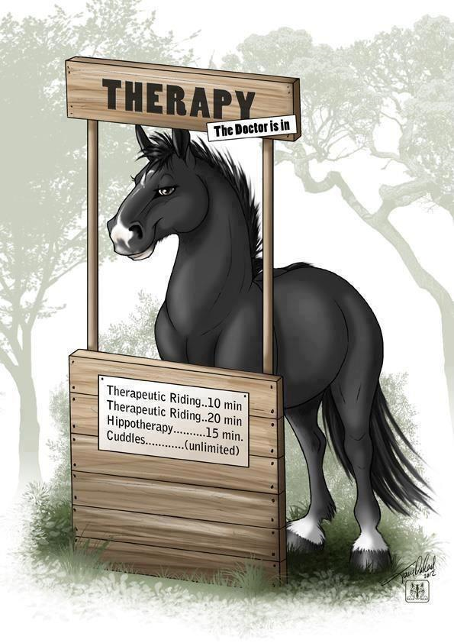
Therapies
Abnormal Psychology Unit

Slide 2
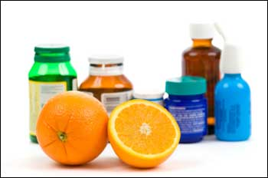
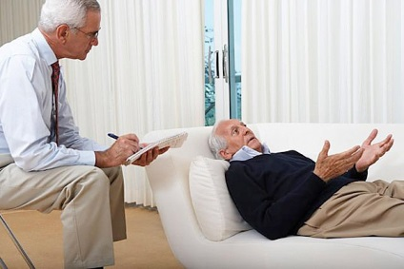
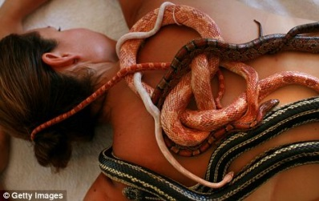
Two main types of therapy
Psychological Therapies
Utilized for psychological disorders (e.g. phobias)
Psychotherapy: planned emotionally charged interaction between therapist and patient
Biomedical Therapies
Utilized for biologically rooted maladies (e.g. schizophrenia)
Prescribed medication or procedure

Slide 3
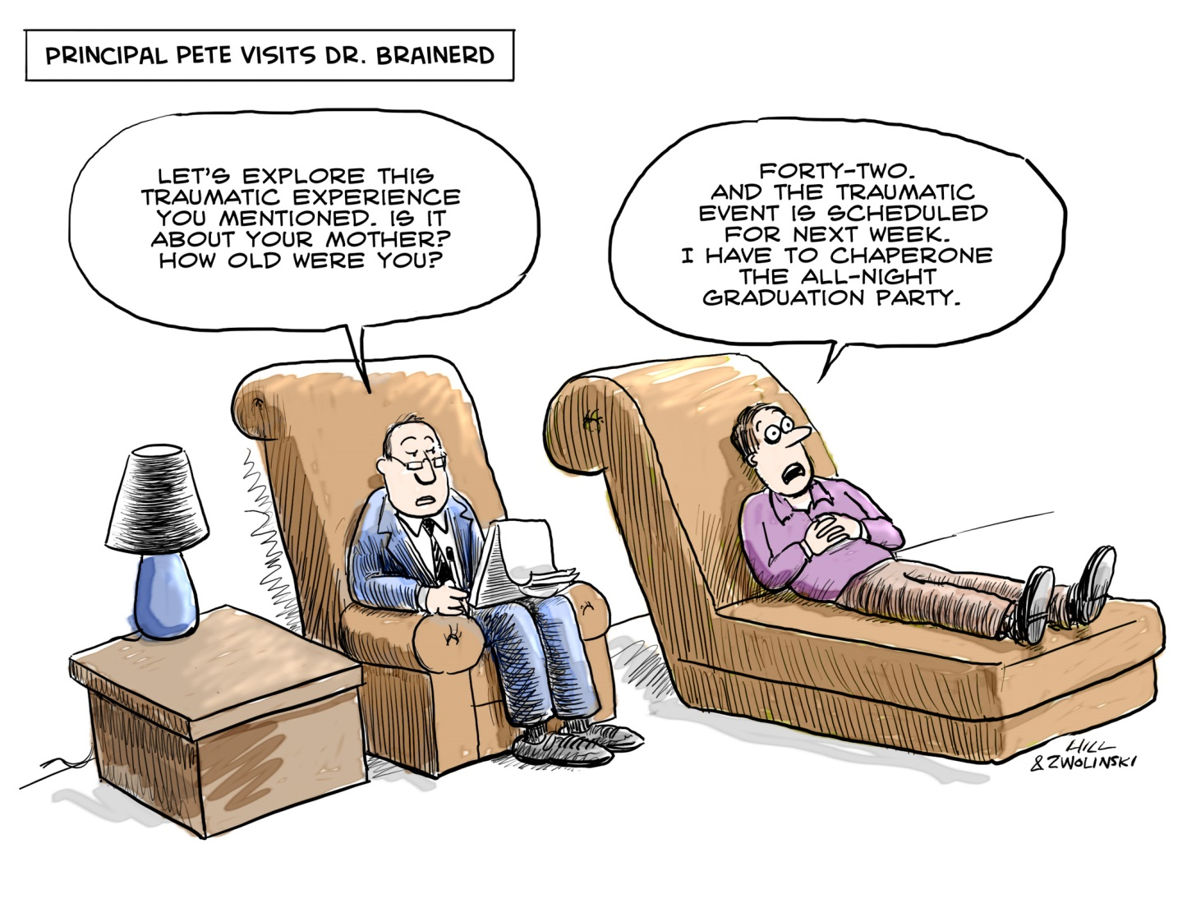
Psychological Therapies
Psychoanalysis

Slide 4
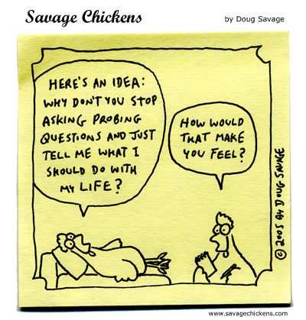
Psychoanalysis
Freudian theory
Principles of theory
Problems are fueled by childhood repressions
Goal: to surface these repressed conflicts, so that the patient can deal with them.

Slide 5
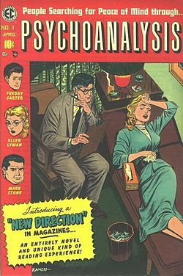
Methods of Psychoanalysis
Free Association
Patient says aloud whatever comes to mind without filtering
Blocks to free association are called resistance
Psychologists interpret resistance to provide meaning
Dream analysis
Transference: projecting feelings towards important people in one’s childhood onto a therapist
Insight into current relationships

Slide 6
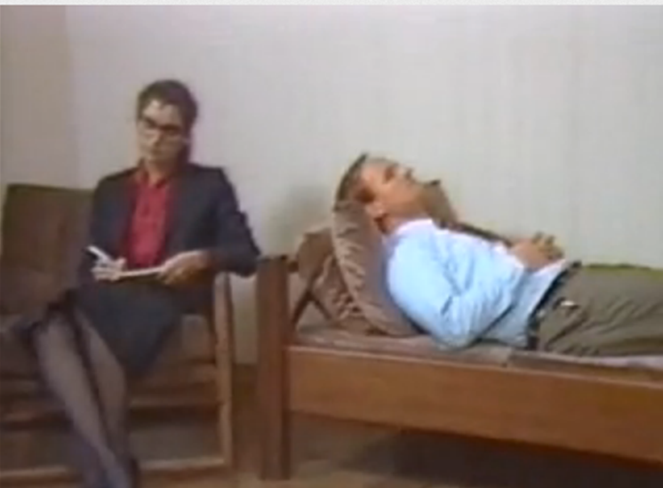
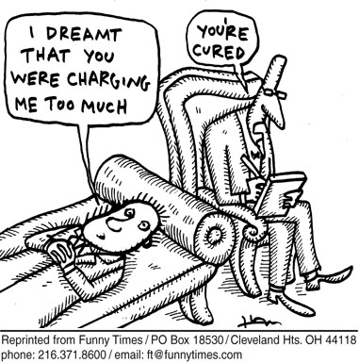
Problems with Psychoanalysis
Not empirical: cannot be proven or disproven
Therapy not science
Lengthy (several years, several sessions per week)
Expensive

Slide 7
Psychodynamics
Look for themes across important relationships
Different from psychoanalysis
Converse face-to-face
Less frequent
Encourages insight
Interpersonal psychotherapy
Effective in treating depression
Goal: Symptom relief, not personality change
Focus on root cause

Slide 8
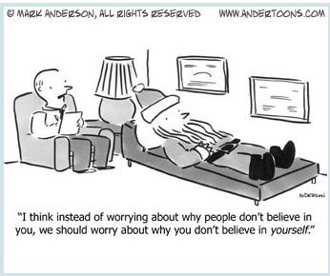
Psychological Therapies
Humanistic Therapy

Slide 9
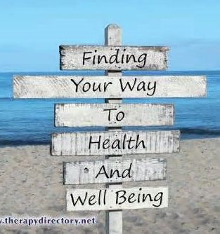
Humanism
Emphasize people’s potential for self-fulfillment.
Grow in self-awareness and self-acceptance.
Focus
Present and future (not past)
Conscious (not unconscious)
Taking responsibility (no hidden determinates)
Promoting growth (clients not patients)

Slide 10
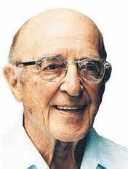
Client-Centered Therapy
Focus on client perspective, not therapist interpretation
Nondirective therapy
Encourage genuineness, acceptance, and empathy
Value in listening and empathy
Active listening: echoing, restating, seeking clarity (paraphrase, invite clarification, reflect feelings)
Carl Rogers

Slide 11
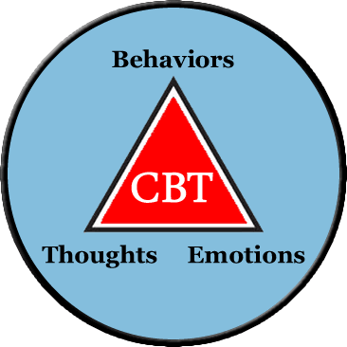
Psychological Therapies
Behavioral Therapy

Slide 12
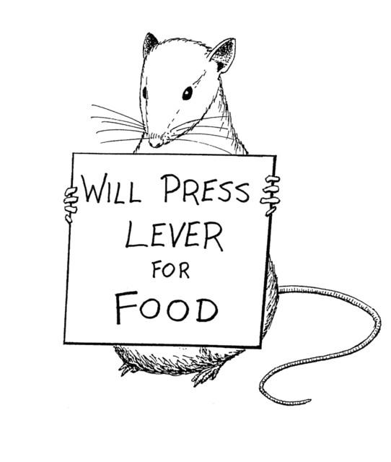
Behavior Therapies
Utilizes learning to treat behaviors (largely phobias and sexual disorders)

Slide 13
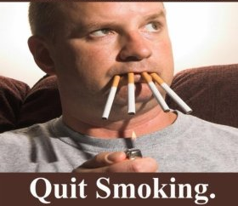
Classical Conditioning
Behaviors are conditioned responses
Bed Wetting: O.H. Mowrer
When child wets bed alarm is sounded, bed wetting is cured 75% of the time
Counterconditioning
Replace fear
Two types: exposure therapy and aversive conditioning

Slide 14
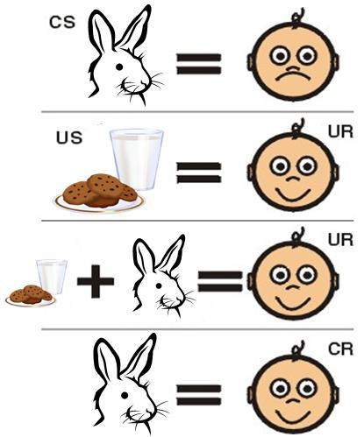
Exposure Therapy
Mary Cover Jones 1924, rabbit experiment
Therapy formalized by Joseph Wolpe
Habituate with repeated exposure
Types
Systematic Desensitization
Virtual Reality Exposure Therapy
Mimic the fear causing experience

Slide 15
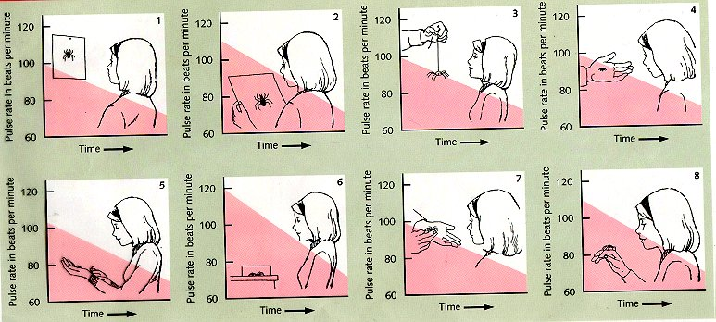
Systematic Desensitization
You cannot be anxious and relaxed at the same time
Repeated relaxation paired with anxiety causing experience, reduces anxiety
Progressive relaxation paired with visualization of increasingly anxious events

Slide 16
Aversive Conditioning
Substituting a negative response for a positive response to a harmful stimulus: aversion to something one should avoid
Reverse of systematic desensitization
Painting nails with bitter nail polish
Short term results, less long term results perhaps due to distinguishing

Slide 17
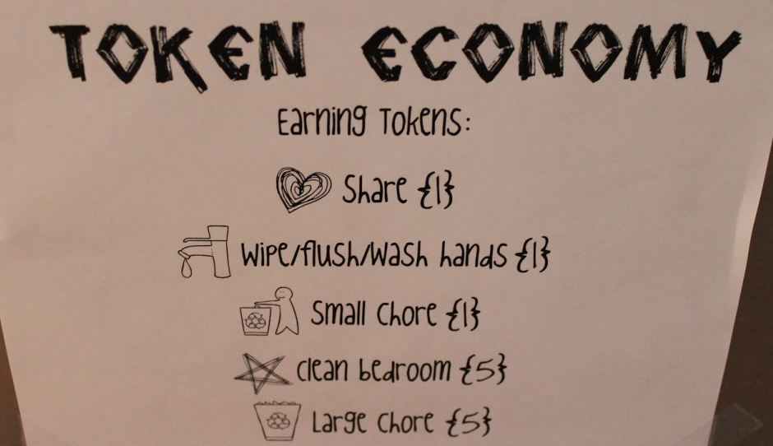
Operant Conditioning
Motivates changes in behavior through punishment and reward
Useful in helping individuals suffering from schizophrenia and autism
How can we modify behavior that is more conducive to daily life and more socially acceptable
John Nash?
Token economy behavior modification
Rewards desired behaviors with some kind of token
Tokens can be exchanged for privileges or small prizes
Orthodontist
Leaves us with two questions
Is it ethical?
What happens once we stop rewarding behavior?

Slide 18
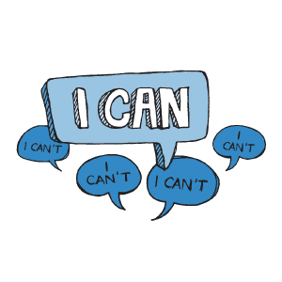
Psychological Therapies
Cognitive Therapy

Slide 19
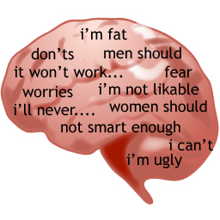
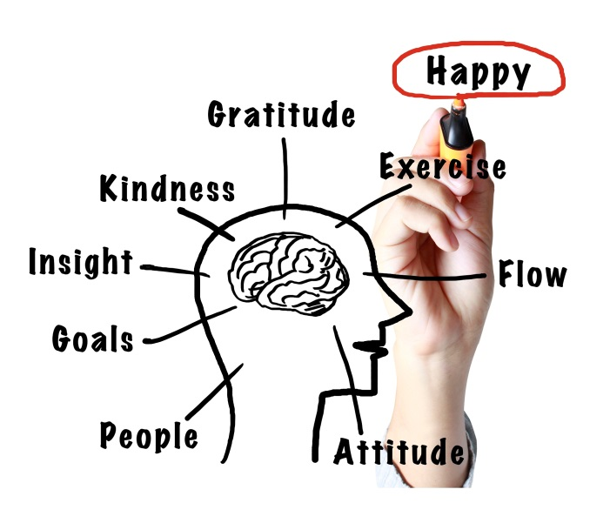
How does it work
Focuses on adjusting thought processes as well as the behavior of the individual
Targets feelings of self-blame and worthlessness
Appear to be one of the best types for depression
Self-serving bias is often missing in depression
Illustrates benefits of optimistic explanatory style

Slide 20
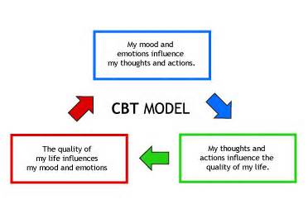
Cognitive Behavioral Therapy
Pairs changing thoughts with changing actions
Helps individuals become aware of their irrational thoughts so that they can resist or modify inappropriate behaviors
Often utilized for OCD
John Nash?
Teaches replacement behaviors

Slide 21
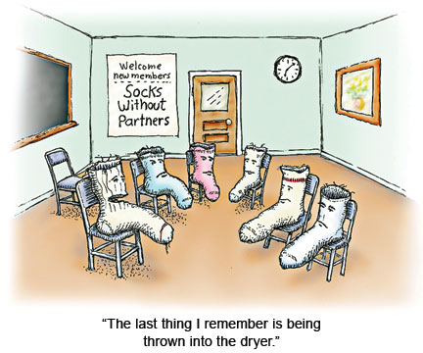
Group Therapy
Small groups, meet once a week, about 90 minutes
Cognitive, behavioral, and humanistic
Pros?
More bang for your buck
Cheaper
“I am not alone!”
Sense of community
Family Therapy
Views the individual’s behavior as influenced by the family
Improve communication and foster positive relationships. Conflict resolution

Slide 22
Does Psychotherapy Work?
Practiced by predominately by psychologists, social workers, nurses, and counselors
Clients believe it is effective
Clinicians believe it is effective
Research is mixed
Nonpsychotic disorders improved with therapy, but those on a waitlist for help improved at the same rate…
Most research says it does help
Time does heal, but therapy helps
Depends on the type of disorder
Cognitive, interpersonal, and behavior therapy=depression
Cognitive-behavioral=bulimia
Behavioral=enuresis

Slide 23
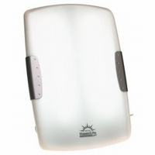
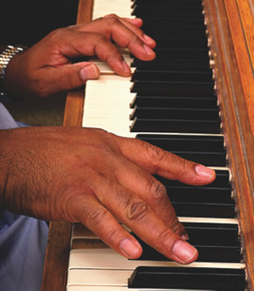
Alternative Therapies
Abnormal Psychology

Slide 24
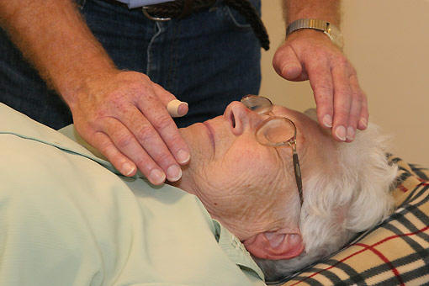
Types of Alternative Therapies
Many types!
Therapeutic Touch
“push energy fields into balance”
Don’t actually touch the person
Validity: very low
Journal of American Medical Association: human energy field doesn’t exist
Light Exposure Therapy
Seasonal Affective Disorder: type of depression
Proven effective
Melatonin

Slide 25
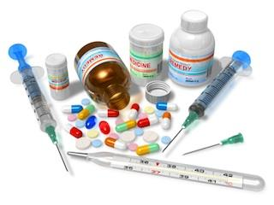
Biomedical Therapies
Abnormal Psychology

Slide 26
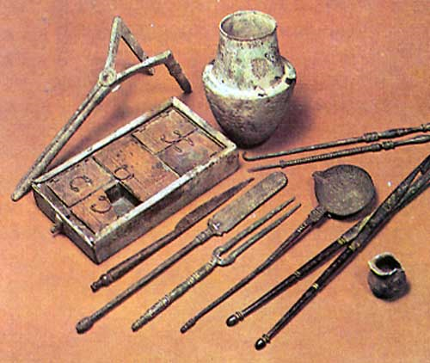
History of Drug Treatment
1800s: Institutions were poorly equipped: bare rooms, chains, no activities
Time of padded rooms, straight jackets, and cruelty
Deinstitutionalization: as drugs became more available patients could leave large institutions and could be treated in the community.
Problem: homeless population has exploded

Slide 27
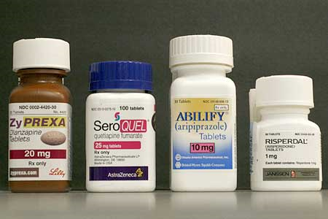
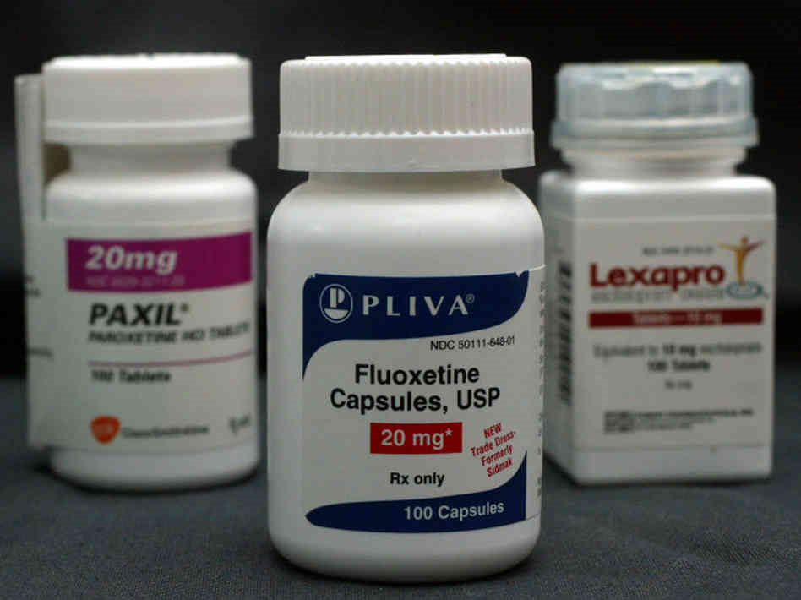
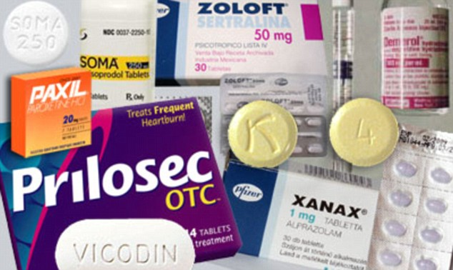
Types of Drug Therapies
Antipsychotic Medications
Largely used for schizophrenia
Antianxiety Medications
Largely used for stress response
Antidepressant Medications
Largely used for mood disorders

Slide 28
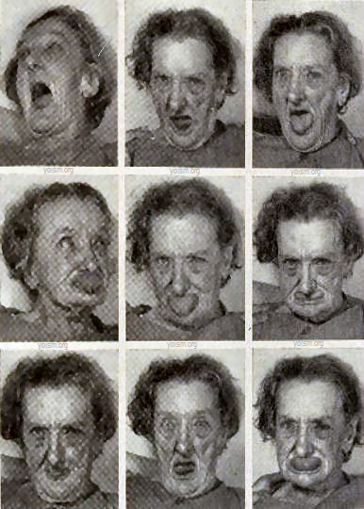
Antipsychotic Drugs
Purpose
Reduce delusions, direct focus away from the insignificant and towards important things
How?
Block dopamine (remember high levels of dopamine are associated with schizophrenia)
Example
Thorazine: first one, still on the market, many negative side effects
Tardive Dyskinesia: similar to Parkinson’s—limited muscle control
Clozaril: considered most effective, fewer negative side effects
Risperdal
All very expensive and none produce a “high”

Slide 29
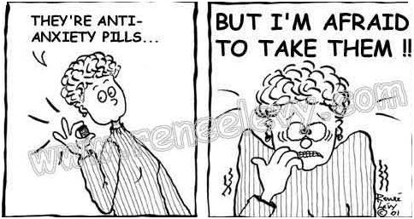
Antianxiety Drugs
Purpose
Help individuals cope with significant stressors
How?
Partly by boosting GABA, which helps reduce anxiety and acts as a sedative and boosts mood
Example
Valium, Librium, Xanax
Problems
Can be habit forming and don’t solve the problem (should be used with psychotherapy)

Slide 30
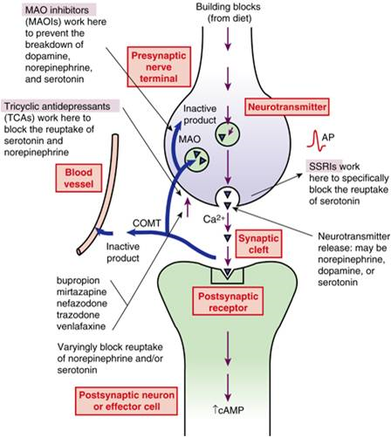
Antidepressant Drugs
Purpose
Treat major depression
How
Different types do different things
Many boost serotonin
Examples
Prozac, Zoloft, Paxil
Selective serotonin reuptake inhibitors
Lithium drugs
Used for treatment of bipolar disorders
Accounts for $6 billion of prescription medication (1999!)
Usually require about a month to see any changes
Can be correlated with suicidal thoughts
Effective?
Depression is naturally cyclical
High rates of placebo effect

Slide 31
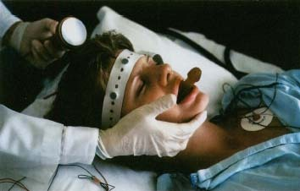
Electroconvulsive Therapy
Passing electric current through the brain until convulsion is produced
Began in Europe in the early 1900s
Showed to be effective in treating depression
3x/wk, for 2-4 weeks
Side effects: soreness, broken bones, memory loss/disruption, no long term brain damage found
Modern adaptations involve muscle relaxers and sedatitves
Why?
We don’t really know?
Jolt of neurotransmitters
Repetitive transcranial magnetic stimulation (rTMS)

Slide 32
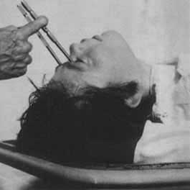
Psychosurgery
Lobotomy: goal disconnect frontal lobe from limbic system or “emotional center”
How? Icepick-like tool, through the eye socket, swing tool to cut at the base of the lobe
Only to be used in severe situations
Often reduced patients to an unmotivated immature state and all they did was sit and stare into space
Lesions: destroy small sections of the brain to control seizures or severe OCD
Not often used because it is permanent

