Slide 1
The Egyptian Empire
Period 2

Slide 2
Major Conflicts
Egyptian Empire

Slide 3
Major Conflicts
The 11th century B.C.E.-16th century B.C.E. covers the eighteenth, nineteenth, and twentieth dynasties of Ancient Egypt.
Eighteenth Dynasty-
1,600 B.C.E- Hyksos’ Conquest of Egypt.
Thutmose III, otherwise known as the Napoleon of Egypt, expands Egypt’s army.
Amenhotep IV promotes the artists of Egypt and leads to flourish of realism.
The Hittites extend their influence to Egypt and become a major political power.
Nineteenth Dynasty-
Ramesses II recovers territories in Levant.
The Battle of Kadesh occurs, leading against the Hittites. The battle was a draw, and brought on a treaty between the two nations.
Twentieth Dynasty-
The Sea Peoples invade Egypt by land and sea and are defeated by Ramesses III.
The Sea Peoples invasion inadvertently creates a new state named Philistia after final collapse of the Egyptian Empire.
Lack of sunlight prevents tree growth for two full decades speculated to be caused by the eruption of Hekla 3 in Iceland.
Droughts, below-normal flooding of the Nile, famine, civil unrest and official corruption occur as part of the bickering of Ramesses III’s heirs.

Slide 4
Territory
Egyptian Empire

Slide 5
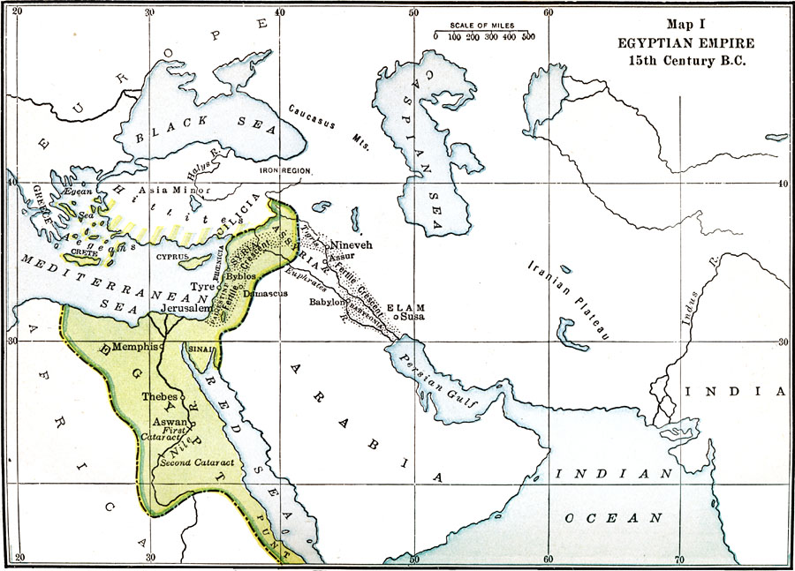
Egyptian Empire (16th Century BCE-11th Century BCE)
This is a picture of the Egyptian Empire, 15th Century BCE

Slide 6
Leaders and Politics
Egyptian Empire

Slide 7
Egyptian Empire – Leaders and Politics
The reign is held by what can be called either kings or pharaohs, and held for a considerably long amount of time (usually until death).
King Akhenaten - 10th king of Dynasty 18, most controversial ruler of Ancient Egypt, made all other Gods “disappear” during 8th year, and made Aten the only known God, and built capital named after himself.
King Thutmose III – Remembered as the great warrior pharaoh, the wealth from his campaigns allowed him to build more than 50 temples, and completely rebuilt and expanded Karnak.
Pharaoh Tutankhamun – Extensively restored temples ruined by Akhenaten, abandoned Armana for Memphis and Thebes, and lies in a furnished tomb discovered by Howard Carter.
Pharaoh Haremhab – Succeeded Aya as King, and royal scribe and general of the army under Tutankhamun.
Name means:
“Effective for the Aten”
Name means:
“Son of Thoth”
Name means:
“Living Image of Amun”
Name means:
“Horus is in Jubilation”
Akhenaten
Thutmose III
Tutankhamun
Haremhab

Slide 8
Empire Beginnings and Ends
Egyptian Empire

Slide 9
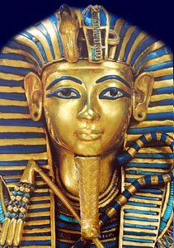
Egyptian Empire Beginning and Ending
End of Empire:
Late Period
By 525 BC the Persians began taking over Egypt and captured Egypt’s pharaoh
Ptolemaic Dynasty
In 332 BC the Persian ruler handed Egypt to Alexander the Great and it became a province of the Roman Empire in 30 BC
Empire beginning:
Also known as Ancient Egypt
The empire was made from people in Northeastern Africa
They settled around the Nile River and the ability for them to adapt to the Nile River conditions led them to the success of Egyptian civilization in 3150 BC
The Egyptian Empire was made because of the unification of Upper and Lower Egypt under the first pharaoh

Slide 10
Cultural Contributions
Egyptian Empire

Slide 11
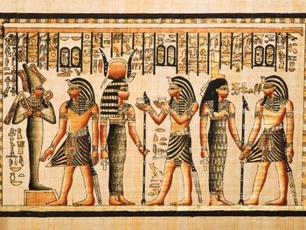
Cultural Contributions
Science:
Egyptian calendar was based of a year of 365 days, with twelve months and three seasons
Astronomy
Medicine
Remedies and prescriptions for various ailments, wounds, stomach complaints, skin irritations, broken bones and many other conditions were recorded on sheets of papyrus
Religion:
They developed the first thought forms of the Godhead, the beginnings of a religion
Art:
buildings were decorated with paintings, carved stone images, hieroglyphs and three-dimensional statues
The art tells the story of the pharaohs, the gods, the common people and the natural world of plants, birds and animals
Society:
They made the first paper in history from the papyrus plant
They made perfumes from flowers
They formed an alphabet of 24 letters

Slide 12
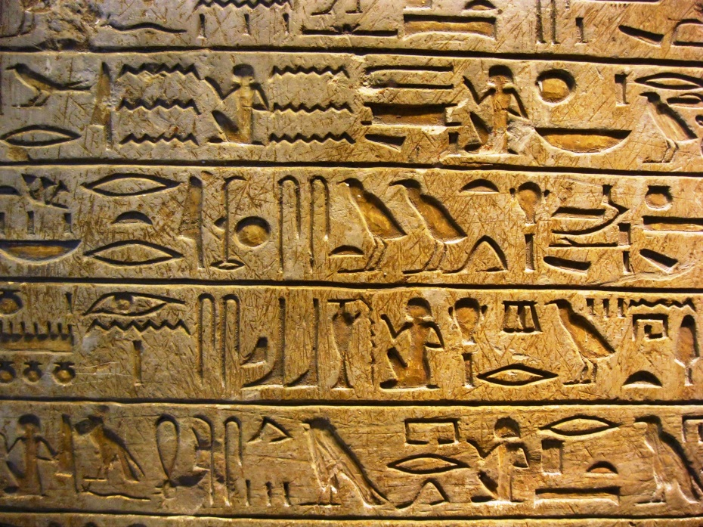
Cultural Contributions
Technology:
Clocks
a water clock and a sundial
Mathametics
Architecture:
They mastered metals making jewelry of gold and other objects from iron and bronze like hinges, needles and nails
They built the first columns in history in Saqqara
pyramids, tombs, temples and palaces out of stone

Slide 13
Historical Significance
Egyptian Empire

Slide 14
Historical significance
Also was known as the new Kingdom of Egypt. Thutmose III expanded his army during the eighteenth dynasty, leading to promising gains in wealth and territorial expeditions.
Sustained life in harsh regions by creating predictable flooding and irrigation control.
Egyptian hieroglyphs, were used as the writing system. (The alphabet)
Improved on quarrying, surveying and construction techniques, that helped in building pyramids and temples.
Had proficient and effective medicine remedies
Created the first known ships
Left a big imprint with Egyptian art and architecture, they were commonly copied.

