Slide 1
Persian Empire

Slide 2
Index
Leaders – Sam M
Territory – Victoria K
Major Conflicts – Daniel M
Brief Timeline – Daniel M, Lesly V
Origin/End – Jagdeep Singh
Cultural contributions – Juila T
Historical Significance – Isacc L

Slide 3
Leaders
Cyrus The Great
Xerxes, fourth king of Persia
Founder of the Achaemenid Empire
Built the Empire of conquering three others
His rule lasted 3 years
He respected the peoples customs and beliefs of those he conquered
Known for his ahievements in human rights, politics, and military strategy.
Name lierally means “King of heoes”
Father darus elected him as his seccessor before he led a war campaign, saddly he died before it could launch due to poor health.
He his best known for leading the invasion on the greek homeland.
Had one of the most legendary battles with King Leonidas and his 300 Spartans
Also created a new class of solider in the Persian army called “the Immortals”

Slide 4
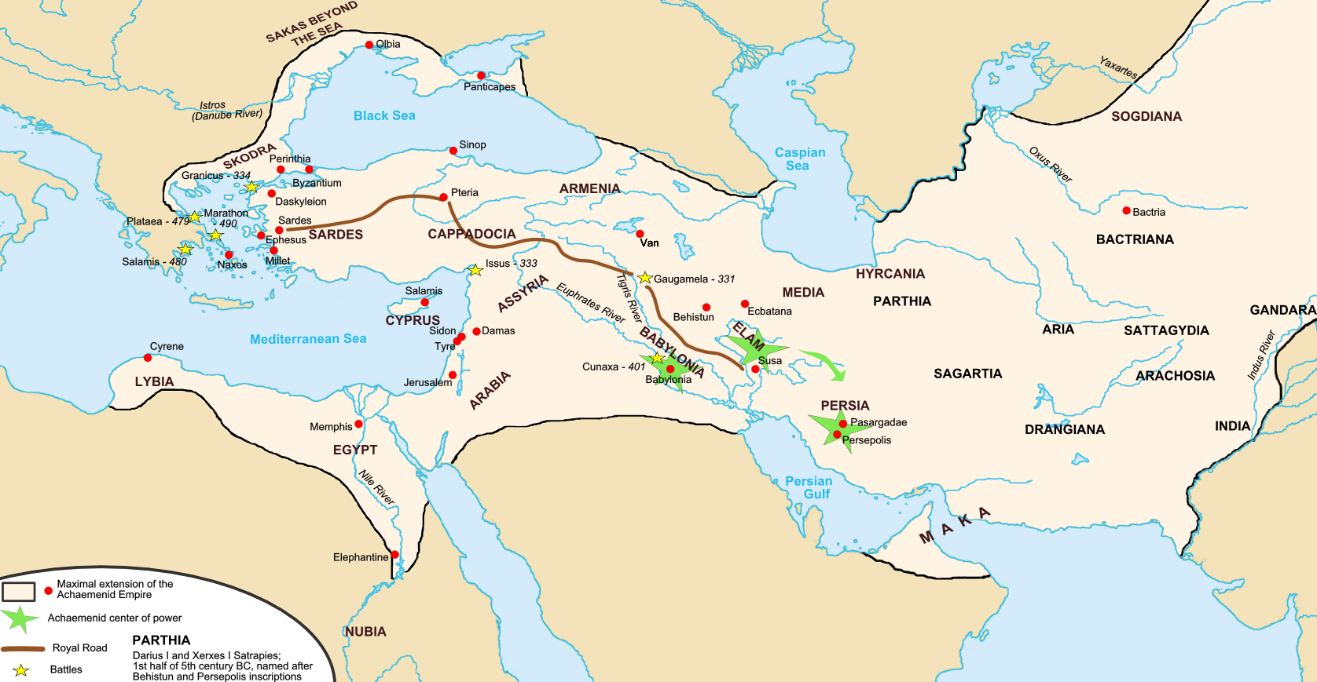
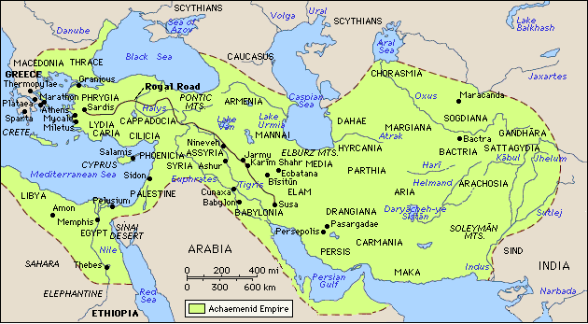
Territory

Slide 5
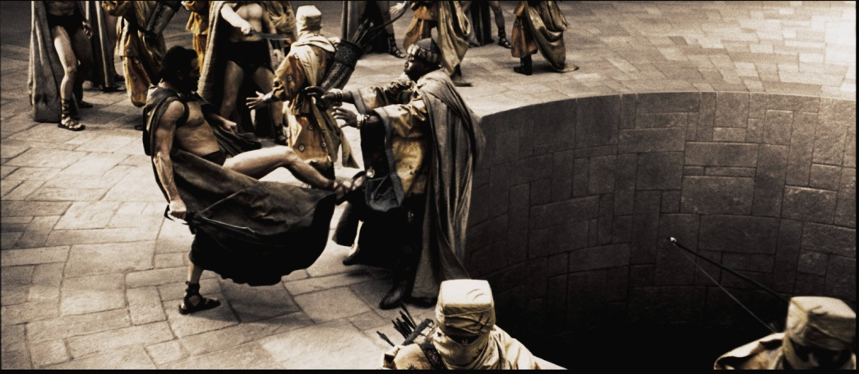
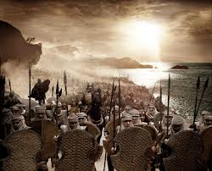
Major Conflicts
Greco Persian war 492-449BC
Persian Revolt 550 BC
Conquest of Lydia 547 BC
Conquest of Babylon 539 BC
Conquest of Egypt 525 BC
Fall of Macedonia 330 BC

Slide 6
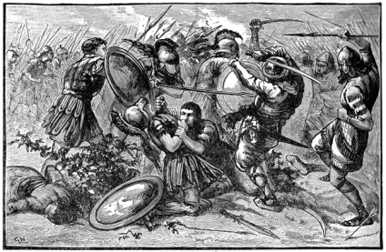
Brief Timeline
Named after west Iranian tribe: Parsua
Started in 675bc
Expanded by Cyrus the Great
Conquered by Alexander the Great
Fell in 330bc

Slide 7
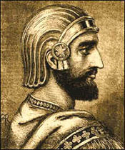
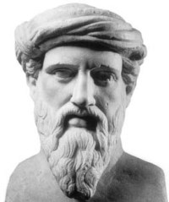
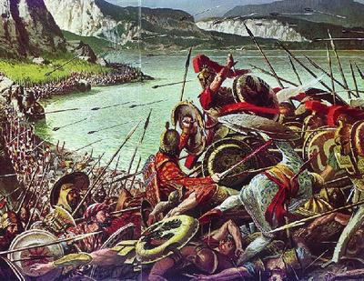
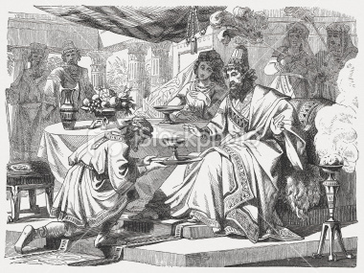
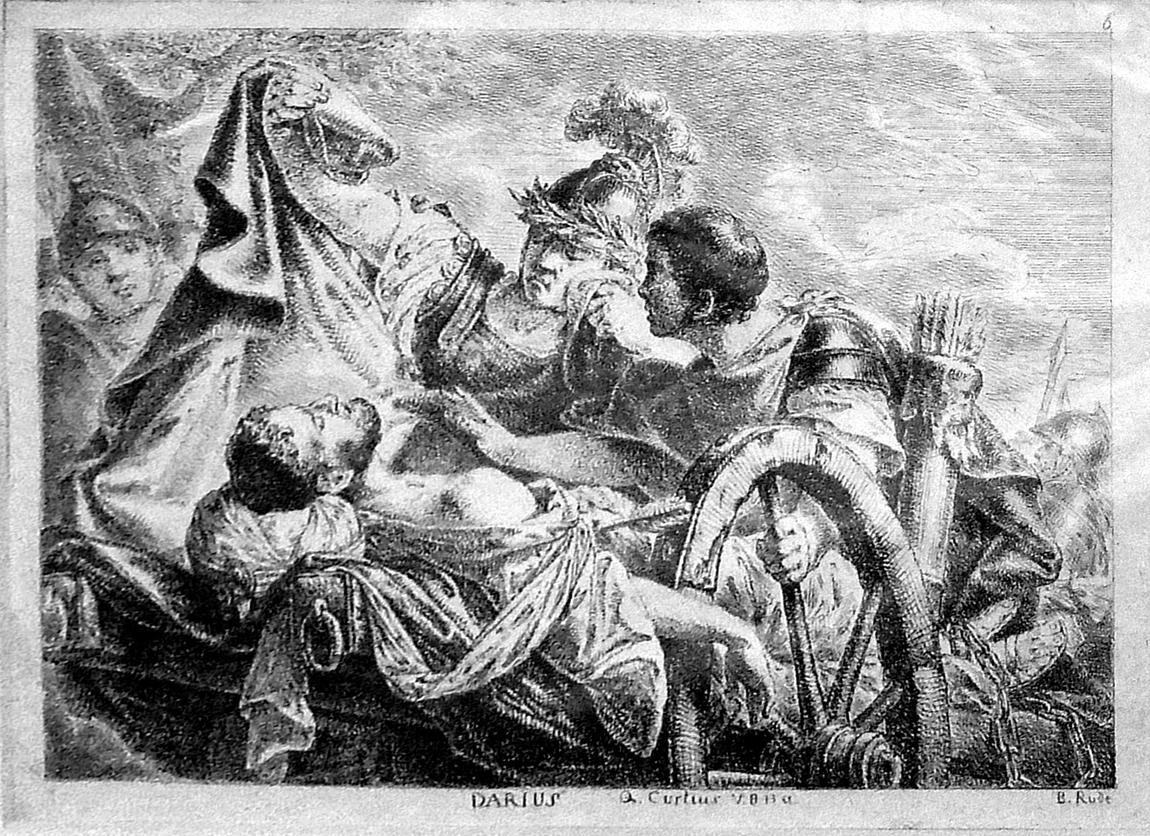
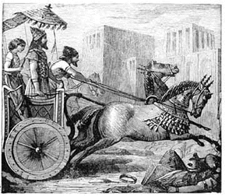
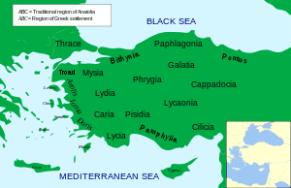
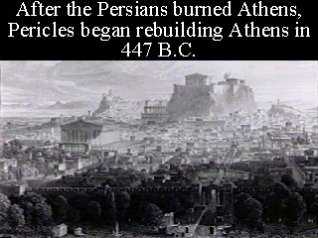
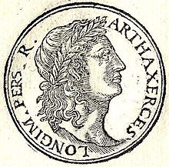
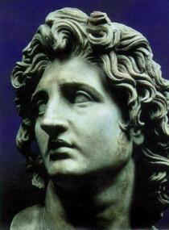
Cyrus is king of Ashan. He starts the Achaemenid dynasty.
Cambyses II rules. He conquers Egypt & Cyprus. He dies in 522 B.C.
Greeks & Persians battle for territory. In 485 B.C. Darius dies.
Artaxerxes takes over empire. In 447 B.C. a satrap from Syria revolts.
Artaxerxes is killed in 338 B.C. Arses takes over, but is killed two years later.
550 B.C.
539 B.C.
529 B.C.
499 B.C.
490 B.C.
485 B.C.
465 B.C.
404 B.C.
359 B.C.
336 B.C.
550 B.C.
539 B.C.
March
April
May
June
Cyrus continues his conquest and Babylon is under his control.
Lydia joins Persia after being conquered by Cyrus in 536 B.C.
Xerxes comes to power. Persians burn Athens in 480. Xerxes is assasinated in 465.
Artaxerxes is king. He rules longer than any persian king. Egypt is led succesfully.
Darious III takes over. 334 Alexander the great invades Asia.

Slide 8
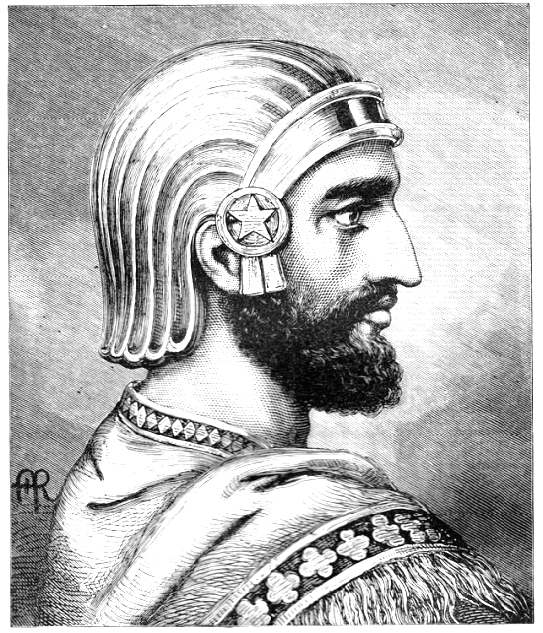
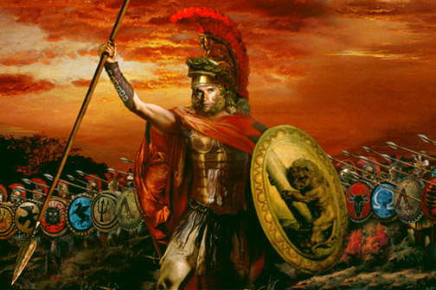
End
Origin
After the death of Xerxes (486-464 B.C.E.), the Persian Empire lacked a strong ruler to keep things running smoothly. As a result, various problems developed that fed back upon one another and led to Persia’s fall. Weak leaders led to revolts, mainly in Egypt, which had always detested Persian rule. The provinces became more independent, ruling as kings more than the king’s loyal subjects. The even carried out their own foreign policies and started wars with each other. The empire grew weaker every day and when Alexander the Great attacked around 400 B.C.E., he conquered in a remarkably short time and with a remarkably small army.
Around 550 B.C. Cyrus the Great, a Persian king, took control of the land that connects east and west Asia called Media from the Medes. He formed a government and chose both Median and Persian nobles to be civilian officials. Next, he used his strong military to attack states throughout Asia Minor. He went on to conquer the lands to the east known as the Fertile Crescent.

Slide 9
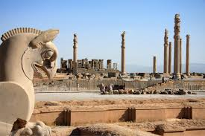
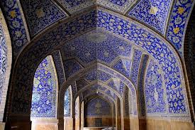
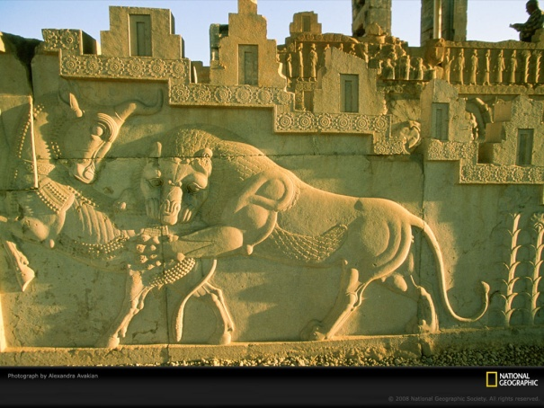
Cultural contributions
Religion-Zoroaster was the prophet who brought this religion to Persia. However, it is not clear when he lived. Dates are given from 1600 B.C. to 500’s B.C. - this is a large range. Most scholars put it at about 1000 B.C. – the time of David.
art- a lot of carving into stone( wall art) and pottery
Science- the Persian empire takes credit for many things that where invented, for example chemistry, numeric system, glass, math/algebra, alcohol and much more
Technology- many technical things appeared in the Persian empire. Public post offices, cement and bricks, the wheel, the calendar, roads and sewers. So many of these thing we still use and are so important to our lives.
Architecture- so much incredible building and statues and all sorts of architecture was left behind. Many amazing building, bridges, statues, many old ruins that are still standing till this day. All of the buildings look like pieces of art and they truly are.

Slide 10
Historical significance
They created one of the first and largest empires.
first people to unite three sites of early urban civilization (Nile Valley, Mesopotamia, Indus Valley) under a single government.
they opened regular communication between three continents -- Africa, Asia and Europe and developed many of the techniques used to govern by later empires.
Even after Alexander’s attack, the empire rose up again and again.

