Slide 1
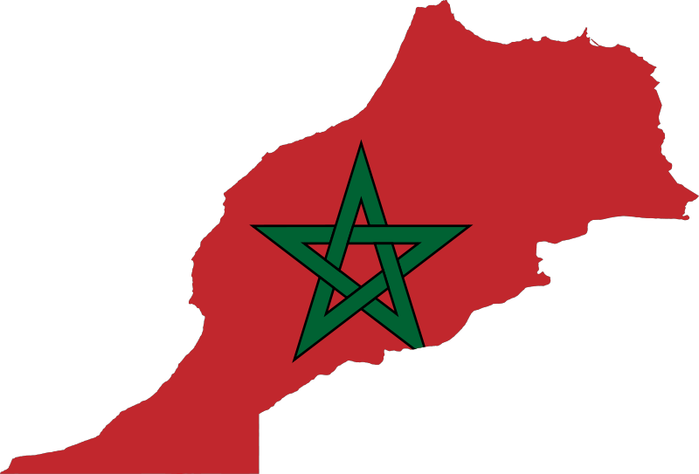
Arab Spring: Morocco
Daniel Metcalf, Sabryna McLean, Breez Halte,Mick McConnell, Pedro Cardenas, Leslie Abramo-Castellano

Slide 2
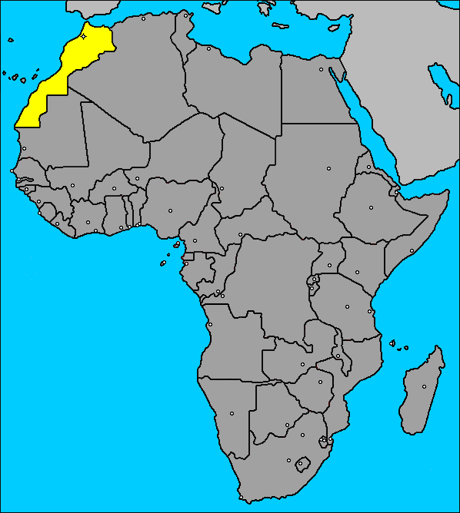
Background On Morocco
Arab Spring: Revolutionary movement of protest, riots, and civil war in the Arab World. Started on Decemeber 8, 2010.
Morocco is located in the Northwest corner of Africa
Culture is a blend of African, European, and Arabian cultures

Slide 3
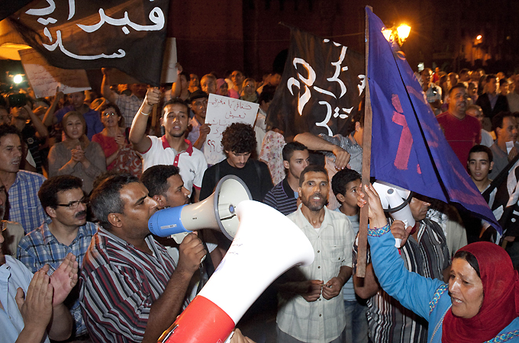
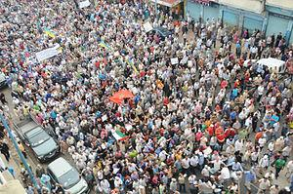
How It Started
First protest was February 20th, 2011
Demanded limits on King’s power and greater social justices such as lower costs of living and and less unemployment
King responds with:
  Constitutional amendments limiting his power
  Call for early election to be less controlled by royal court
  State funding for low-income families
http://www.youtube.com/watch?feature=player_detailpage&v=R8GjQaxWwMA

Slide 4
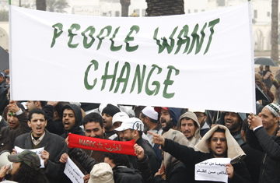
Conflict Development
Majority of the Arab spring in Morocco is nonviolent.
On January 20th, 2012. 5 men lit themselves on fire in protest to widespread unemployment
“Generally speaking, you don’t read much about the ongoing struggle for democracy in Morocco”
There has been a total of 6 deaths due to either police brutality or suicide.

Slide 5
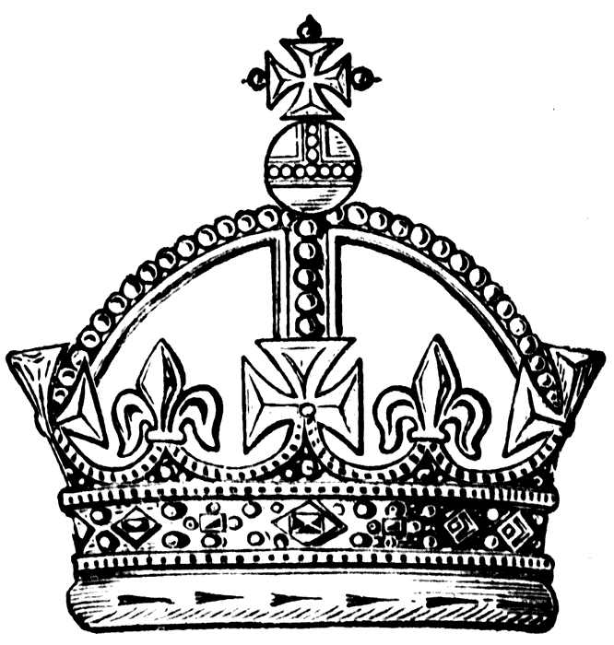
Political and Social Changes
King Mohammed is a member of the Alawite dynasty that has been ruling morocco for 350 years, claiming a direct line of descent from the prophet Muhammad
King Mohammed IV started a reform program and part of the program was to revise Morocco’s constitution. The new constitution was drafted by a commission appointed by the king and adopted in a popular referendum in July 2011, and It broadly aims to strengthen the role of the prime minister.
The king still retains significant power, including the ability to dissolve parliament, he remains commander in chief of the armed forces and the country’s preeminent religious authority.
On February 20, 2011 hundreds of thousands of Moroccans turned out for what organizers called “Movement for change.” The movement rejected the 2011 constitutional revision. The protesters have not called for the removal of King Mohammed but for a constitution curbing his powers.

Slide 6
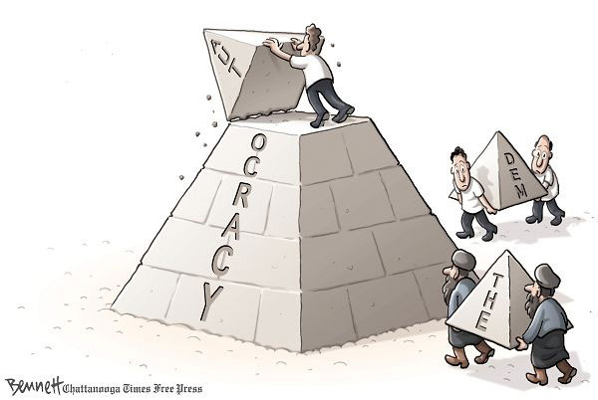
UN Involvement
Protest have been peaceful so the UN have not been very involved
UN urged Moroccan government to not interfere with peaceful protest of civilians

Slide 7
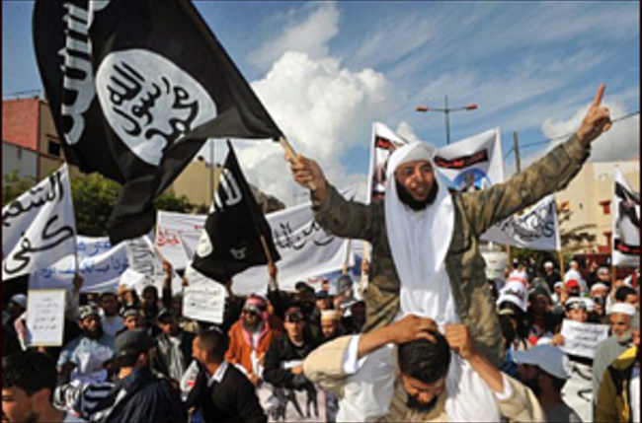
Current Status
Protests in Morocco are demonstrations across the country from February 20, 2011 to the spring of 2012
They were organized by February Youth Movement, large amount being students
Protestor take the streets asking the government to change the constitution
People chanting “down with autocracy” and other slogans against their government
Morocco avoids most of Arab Spring because of Islamist Justice and Development Party were recognized opposition party and came to power in November 2011 elections
“King Mohammed VI announces major political forms, eliminating many of his entitlements and privileges he had enjoyed”
Old Government has regained much of it’s power, Islamist group has also succeed gaining political power.

Slide 8
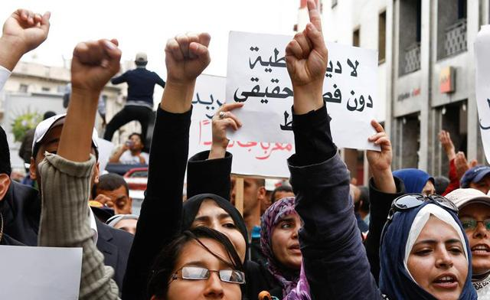
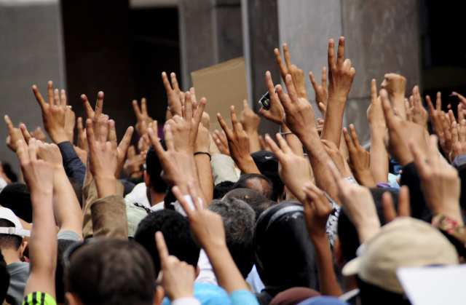
Current status (Cont.)
Moroccans demanded King Mohammed to give up some of his powers.
Citizens of Morocco no longer want a monarchy, but a democracy.
Pro-democracy activists are added up to around 37,000 protesters (2011-2012).
Police are legally allowed to beat pro-democracy activists.
March 2011 finally allowed activists to legally protest peacefully without police intervening.
The king responded by offering constitutional amendments giving up some of his powers.
As of 2012 there are some rallies demanding to keep the monarchy, but so far have failed.
An election was given and is not as controlled as it was before.

Slide 9
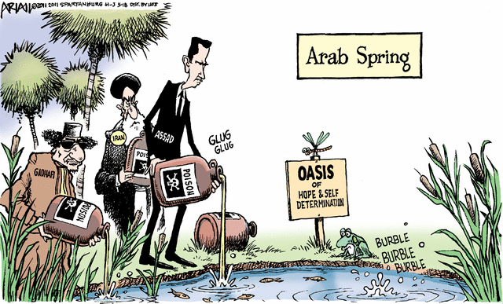
Quiz!!!! :)
Was the Arab Spring in Morocco violent?
Why were there protests?
Who organized the
protest?
What is one thing
the citizens want?
Where is
Morocco located?

Slide 10
Bibliography
"2011–12 Moroccan Protests." Wikipedia. Wikimedia Foundation, 11 Feb. 2013. Web. 04 Nov. 2013. (slide 8)
Amos, Deborah. "In Morocco, The Arab Spring's Mixed Bounty." NPR. NPR, 2013. Web. 04 Nov. 2013. (slide 3)
"Anti-government Protesters Rally in Morocco - Africa - Al Jazeera English." Anti-government Protesters Rally in Morocco - Africa - Al Jazeera English. Al Jazeera, 12 Aug. 2012. Web. 05 Nov. 2013. (slide 3)
"Morocco." News. New York Times, 24 Nov. 2011. Web. 05 Nov. 2013. (slide 4)
Tawill, Camille. "Morocco's Stability in the Wake of the Arab Spring | Combating Terrorism Center at West Point." Combating Terrorism Center at West Point RSS. N.p., 23 May 2013. Web. 05 Nov. 2013. (slide 7)
http://online.wsj.com/news/articles/SB10001424052748703498804576156180408970252 (slide 7)

