Slide 1
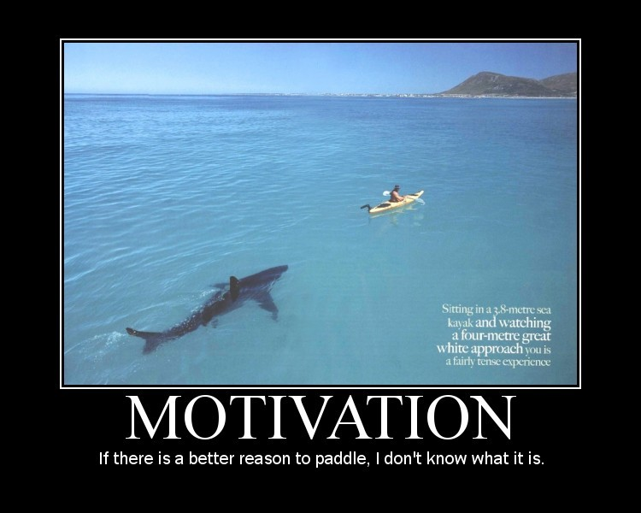
Motivation
Unit Six, Chapter 11

Slide 2
What is motivation
Motivation is the need or desire that energizes and/or directs behavior
Moves us towards our goals
Push (or pull) comes from both psychological, cognitive, and cultural forces.

Slide 3
Theories of Motivation

Slide 4
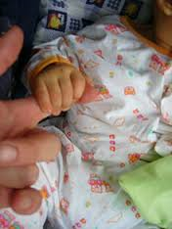
Instinct Theory
Instincts are the same across a species and are innate
Human example: infant rooting and sucking
Human behavior much more driven by wants and needs
Instinct doesn’t explain behavior, but there is a biological connection to human behavior.
Predisposition!

Slide 5
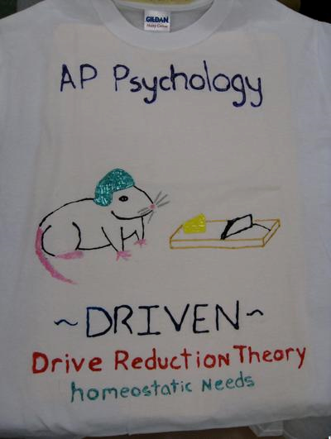
Drive Reduction Theory
Theory Fundamentals: physiological need→psychological arousal
Goal: achieve homeostasis
Homeostasis=tendency to move towards a steady state or equilibrium
Homeostasis is regulated through a feedback loop (results influence a system, output influences input)

Slide 6
Incentives=negative or positive stimuli that lure or repel behaviors
Cupcakes for participating are an incentive
Example:
Food=need, hunger=drive, incentive=tastiness of food, drive reducing behavior=eating
Need
Drive
Drive-reducing

Slide 7
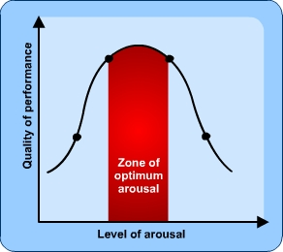
Arousal Theory
But what about behaviors not motivated by a need or drive
Individuals have unique optimal levels of arousal
Humans desire stimulation in order to maintain those levels
Drives much exploratory, creative, and adventure seeking behavior

Slide 8
Maslow’s Hierarchy of Needs

Slide 9
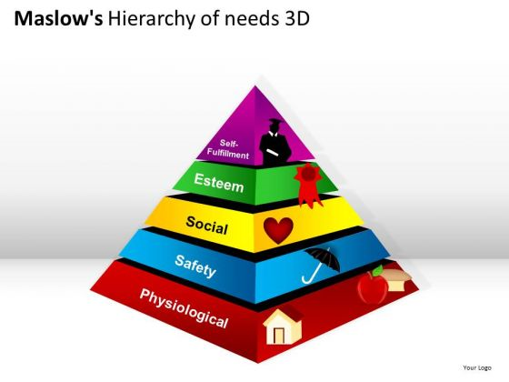
Hierarchy of Needs
Ranks human priority
Needs above safety are uniquely human
Highest level is self-actualization (aka living to one’s fullest unique potential)
But achievement here is really hard to measure
This isn’t 110% true for everyone all the time
But it can be true
Poor countries: satisfaction comes from finances
Wealthy countries: satisfaction comes from esteem

Slide 10
Hunger
Psychology of Motivation

Slide 11
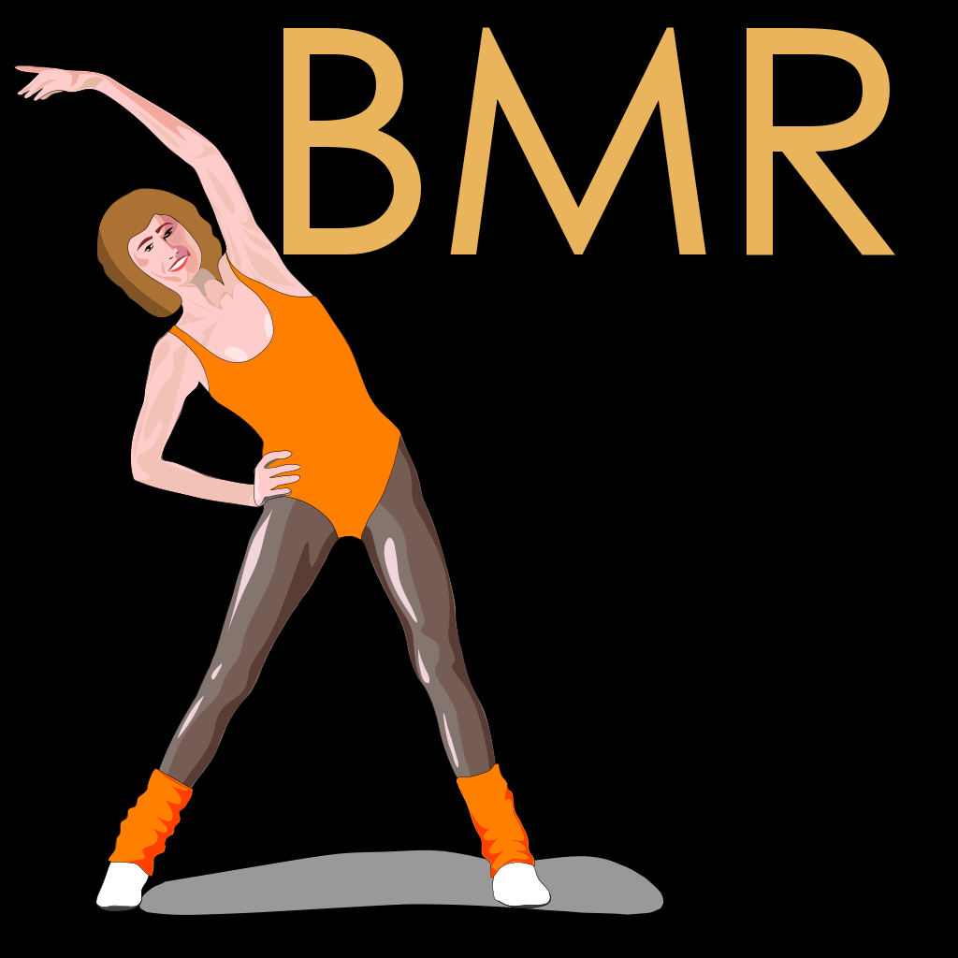
Physiology of hunger
Homeostatic System: desire to maintain normal weight and nutrient supply
Biological patterns, such as BMR, change to maintain weight set points (heredity influences body type and set point)
Basal Metabolic Rate: rate of energy used while at rest
Fidgetors weigh less than non-figetors
Questions about set-points

Slide 12
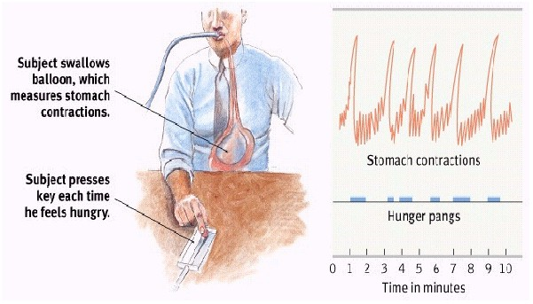
Stomach contractions
Cannon and Washburn say yes!
Balloon experiment
But patients without stomachs still get hungry
We still get hungry even when our stomachs are full

Slide 13
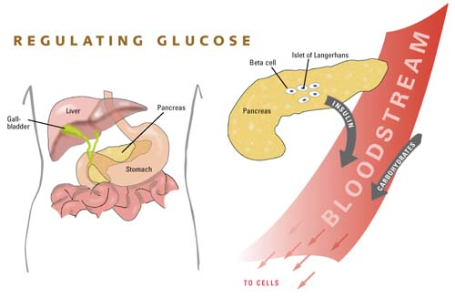
Glucose
Glucose=blood sugar
Excretion of insulin→less glucose
Insulin is a hormone that processes glucose
As the body’s level of glucose goes down hunger increases

Slide 14
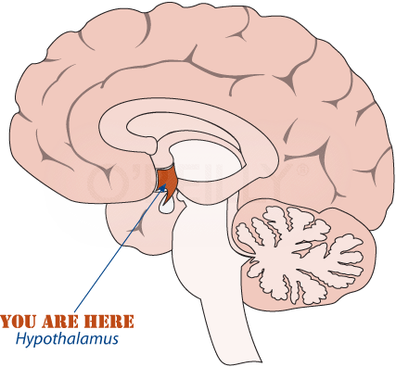
Hypothalamus
Activity in the lateral hypothalamus leads to feelings of hunger (lack of activity lack of appetite)
Produces origin (hormone which triggers hunger)
Activity in the ventromedial hypothalamus depresses hunger (more activity less hunger)
Patients with tumors in these areas sometimes experience increased appetite and weight gain.

Slide 15
Arousal Hormones
Ghrelin is a hormone that increases hunger
Secreted by an empty stomach
Gastric bypass works because the remaining stomach produces less ghrelin
Leptin is a hormone that reduces hunger secreted by fat cells
PYY suppresses appetite
There are still questions surrounding PYY as a appetite suppressing hormone

Slide 16
Psychology of Hunger
Taste preference is biological and cultural
Carbs increase seratonin
Sweet and salty is universal
Taste aversion or if you eat lots of salty foods you will start to like excess salt
Wary of novel foods (especially animal based)

Slide 17
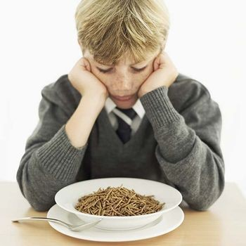
Eating Disorders
Often starts with a desire for abnormal thinness
Other types of eating disorders occur (some even include over eating)

Slide 18
Anorexia Nervosa
Often begins with excess dieting→extreme starvation
Patients must be significantly below normal body weight (usually 15%+)
Usually affects female adolescents (90% of reported cases)
Often correlates with a desire for control and/or other negative life events

Slide 19
Bulimia Nervosa
Starts with a mid-diet binge.
Repeated episodes of overeating (binging) followed by vomiting, laxative use, fasting, or excessive exercise (purging)
Correlates with depression and anxiety following and during binges
Approx 50% of anorexia nervosa patients also suffer from bulimia like symptoms
Harder to notice: weight fluctuates within or above normal ranges

Slide 20
Psychology of eating disorders
Eating disorders do not necessarily indicate childhood sexual abuse
Family Correlations
Mothers of girls with eating disorder often tend to be focused on weight
Bulimia patients often come from families with higher incidences of childhood obesity and negative self-evaluation
Anorexia patients also often have low self-evaluations and competitive, high-achieving, and protective families

Slide 21
Genetics and Eating Disorders
Identical twins are more likely to both suffer from an eating disorder if one suffers than fraternal twins
Evolutionarily Advantageous? Those who are active in their starvation may go out and look for food.

Slide 22
Culture and Eating disorders
Different cultures view women and weight differently
India: female’s consider themselves close to ideal
Africa: larger size is a sign of wealth and health
West: increase in eating disorders (50% of US women report dissatisfaction with appearance)
Men are more likely to be overweight, women are more likely to perceive themselves as overweight
Women would rather have a perfect body than have a mate with a perfect body (the inverse is true for men)
Media influence
Market influence

Slide 23
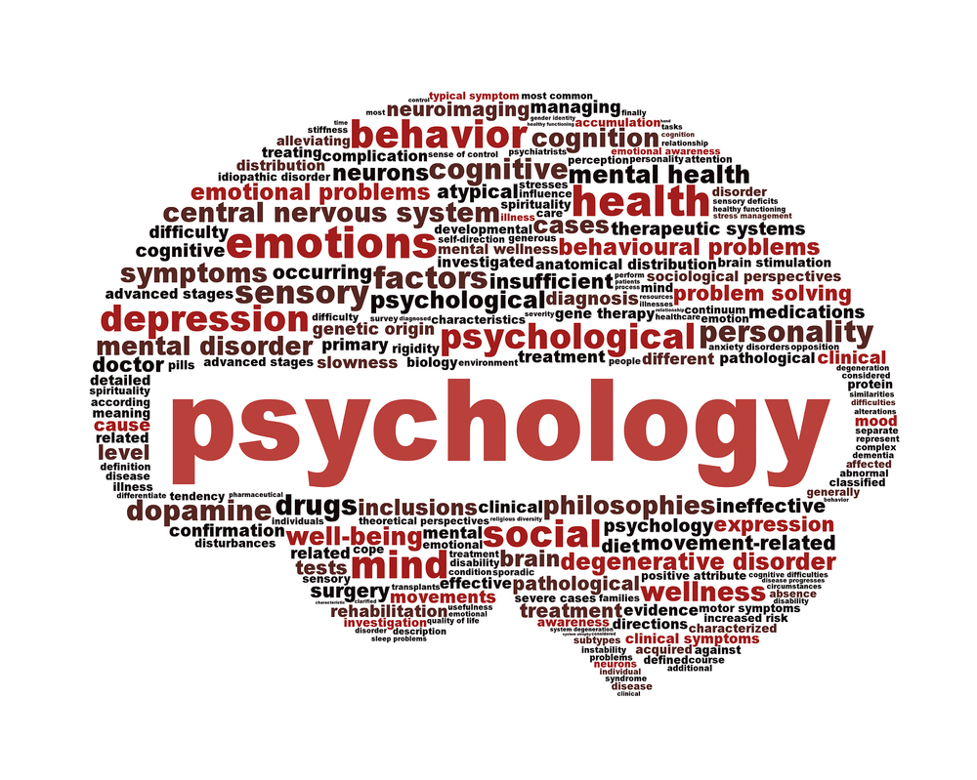
Sexual motivation
Psychology of Motivation

Slide 24
Physiology of Sex
Sexual Response Cycle (Masters and Johnson)—applies to both genders
Excitement phase
Blood flows to genitals
Plateau phase (conception can occur as early as this stage)
Breathing, pulse, blood pressure rises
Blood continues flowing to genitals
Orgasm phase
All over muscle contractions (female genital contractions help to retain sperm)
Breathing, pulse, blood pressure reaches a maximum rate
Resolution phase
Refractory period: time required before capable of the next orgasm

Slide 25
Sexual Disorders
Male: premature ejaculation and erectile dysfunction (inability to have or maintain an erection)
Women: orgasmic disorder (infrequently or never able to experience orgasm)
Cause usually relates to the emotional relationship
Behavior therapy (or in the case of erectile dysfunction, medicine) helps

Slide 26
Hormones and Sexual behavior
Effects: direct sexual behavior and produce sex characteristics
Main Female Sex Hormone: estrogen
Main Male Sex Hormone: testosterone
As a general rule more sex hormones, more sex drive (thus why individuals become more interested in the opposite sex during/after puberty)

Slide 27
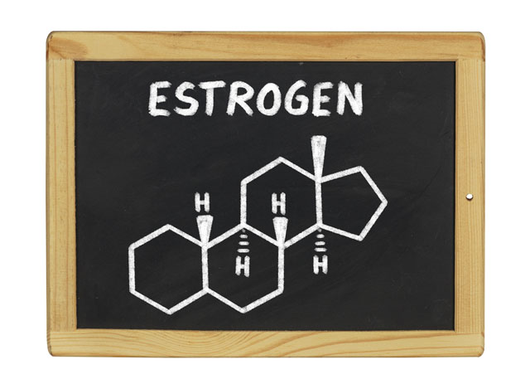
Estrogen
Estrogen peaks at ovulation
Receptiveness increases as estrogen peaks
For humans this is slight and only measurable for those with mates

Slide 28
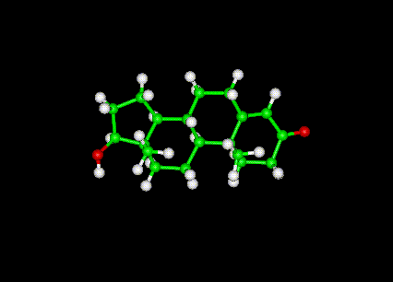
testosterone
Human women are more sensitive to testosterone than other animals
If female testosterone levels drop, sexual desire drops
Male short term fluctuations in testosterone levels don’t affect sex drive
Long term reduction in testosterone does affect sexual drive

Slide 29
Psychology and SEx
Psychology plays a bigger role in human sex drive than does biology
Three factors of motivation for sexual activity:
External Stimuli
Imagined Stimuli
Culture

Slide 30
External Stimuli
Men become aroused when seeing, hearing, or reading erotic material.
Women who report do too!
Male fMRI scans show more active amygdala
With increased exposure to stimulus response lessons (stimulus habituates)
Think of movies: what was rated R for sex/nudity in the 40s versus today!
Viewing media with sexual themes or women has been shown to lead to decreased male satisfaction with their own partners
Unfulfilled expectations

Slide 31
Imagined Stimuli
Patients with spinal cord injuries resulting in no genital sensation still experience sexual desire
In most men and ~40% of women dreams include sexual imagery leading to orgasm
Memories and fantasies can cause arousal

Slide 32
Adolescents and Sexuality
Social and cultural factors
Pre 1900 only 3% of individuals had premarital sex by age 18
Between 40-50% of teens report having sexual intercourse in Canada/US
Rates are higher in western Europe, and lower in Arab and Asian countries
Teen sexual activity is on the decline since 1991

Slide 33
Psychological and social Risk factors for teen pregnancy
Ignorance: lack of information about protection and overestimation of peer sexual activity
Guilt/Shame: reduce sexual activity, but also use of contraceptives
Lack of communication regarding birth control
Alcohol: Positive correlation between teens who use alcohol and teens who engage in sexual activity. Alcohol lessons judgment, inhibition, and self-awareness.
Media Norms

Slide 34
Social and psychological restraints to teen sexual activity
High intelligence
Religiosity
Father presence
Participation in service learning programs

Slide 35
Sexual orientation
Homosexual orientation: sexual attraction toward members of our own sex
Heterosexual orientation: sexual attraction toward members of the opposite sex
Behavior does not equal orientation
Can social factors and social psychology affect research in this field? How?

Slide 36
Psychological studies on sexual orientation
“Most psychologists view sexual orientation as neither willfully chosen nor willfully changed”
Erotic Plasticity: Adult women’s sexual drive and interests are more flexible and varying than that of male counterparts
Homosexuality was removed from the American Psychiatric Association's list of mental illness in 1973 and the WHO did so in 1993

Slide 37
Origins of Sexual Orientation
Psychological factors do not seem to be a cause
Parental relationships, childhood sexual experiences, peer relationships, dating,
Fraternal birth-order effect: there is a correlation between having older male siblings and male homosexuality. But researches have no explanation as to why

Slide 38
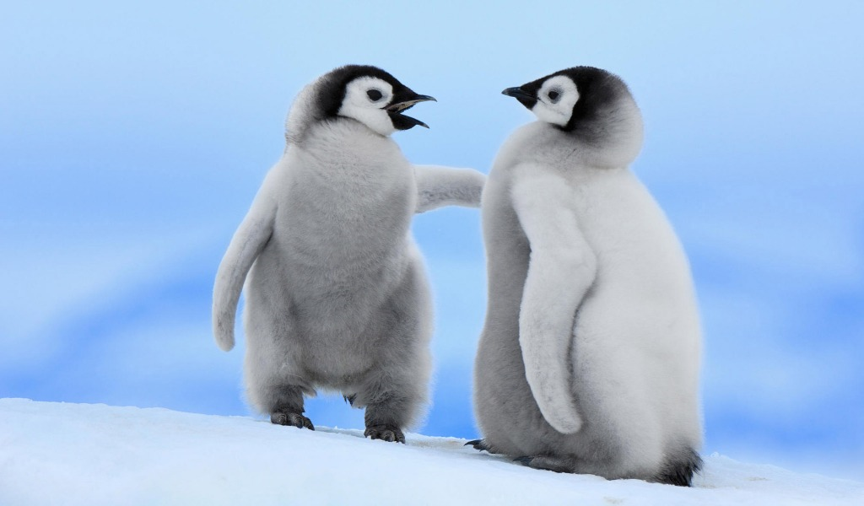
Sexual behavior in animals
Several hundred species exhibit same sex behavior
Penguins, grizzlies, gorillas, monkeys, flamingos, sheep and owls

Slide 39
The Brain and Sexual Orientation
Hypothalamus cell clusters are larger in heterosexual men than in women and homosexual men
Hypothalamus lights up in women in response to male sweat, and in homosexual in response to male sweat
Anterior commissure is 1/3rd larger in homosexual men!

Slide 40
Genes, hormones, and homosexuality
Fruit flies have been genetically manipulated to change sexual orientation
Male twin studies: if an identical twin is homosexual there is an increased chance that the twin is as well (but not always true!)
Critical period during 2nd and 5th trimesters: exposure to certain hormones may affect sexual orientation
Several other examples cited on page 492
Moral of the story: nature over nurture in this situation.

Slide 41
The Need to belong
Humans are social animals
Aristotle, in Nichomachean Ethics, claims without friendship we wouldn’t have will to survive
But Why?

Slide 42
Reasons behind the need to belong
Aiding Survival
Children stay close to caregivers
Those who form attachments are more likely to partner to reproduce and stay together until offspring matures
Cooperation aids hunting and protection (safety in numbers)
Wanting to Belong
Joy when relationships form and sadness when the fail
Relationships are key indicators of happiness and self-esteem

Slide 43
Reasons Behind the Need to Belong
Social Acceptance
Self-esteem is gauged by how valued and accepted we feel
To avoid rejection, we conform
Maintaining Relationships
Fear of being alone
Ending even unhealthy relationships is often painful
Avoiding Ostracism
Ostracism in the animal kingdom serves as punishment
Causes real pain (measured by activity in the anterior cingulate cortex)
Health
Friendships and close relationships are correlated with physical and psychological health

Slide 44
Motivation in the Workplace
Psychology of Motivation

Slide 45
Perspectives on work
Job
Necessary way to make money, not a fulfilling activity
Career
Opportunity to advance from one position to a better one
Calling
Fulfilling and socially useful activity
Individuals with this view point have higher satisfaction with work and life

Slide 46
Flow
Coined by Mihaly Csikszentmihalyi
Optimal balance between stress, apathy, and boredom
Correlates with high degrees of internal motivation, productivity, and success
“Time flies when you are having fun”

Slide 48
Industrial/Organizational Psychology
Application of psychology to the workplace
Subsets
Human factors psychology: designing machines and environments to fit human abilities
Personnel psychology: hiring
Organizational psychology: management

Slide 49
Personnel Psychology: Interviewing
Hiring should match employees with tasks suited to their strengths over experience
Capabilities most indicated by mental-ability
Aptitude tests and work samples highly useful
Interviewers are often a bad judge: Interviewer illusion
People act differently in interviews
Interviewers are people too, they are subject to preconceptions

Slide 50
Interview Types
Structured
Disciplined method of collecting info
Focus on specific job related skills and past work experiences
Interviewer rates interviewee
More accurate
Unstructured
Casual, get-to-know-you approach
Open ended-personality oriented questions
Not as effective, more susceptible to intuition

Slide 51
Appraising Performance
Methods: checklists, graphic rating scales, behavior rating scales
Where does evaluation come from
Supervisor
360°-degree feedback: supervisor, peers, subordinates, customer, self
Better for communication and more complete
Error Sources
Halo Effect: they are nice thus they are better
Leniency and Severity Errors: evaluator is too easy or hard
Recency Errors: evaluator remembers the most recent events

Slide 52
Motivating Achievement
High achievement motivation leads to increased achievement
Self discipline and activity level are both indicators of achievement motivation
Grit! (passionate dedication to ambitious long term goals)

Slide 53
Employee Satisfaction
Satisfied employees are more productive and happier
Satisfaction indicators
Well equipped
Feel fulfilled
Opportunities to do what they do best
Part of something important

Slide 54
Managing Well
Step One: select the right people
Step Two: adjust work tasks to suit individual talents
Set challenging SMART goals
Step Three: care about your employees
Step Four: reinforce positive behavior through recognition and reward

Slide 55
Leadership Styles
Best leadership is combination leadership: appropriate style based on task
Task Leadership
Set standards, organize work, goal-oriented
Social Leadership
Mediate conflicts, team-building, democratic style
Transformational Leadership
Motivate others to identify with and join in the group mission
Good Leadership Personalities: Charisma, communicative, confidence, vision, extroverted

