Slide 1
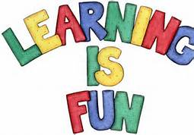
Learning

Slide 2
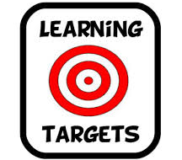
Learning, Learning Targets
I will be able to define learning with appropriate psychological terminology.
I will be able to offer an example of psychological learning

Slide 3
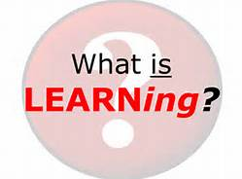
What is learning?
Relatively permanent change in behavior due to experience.
That which is teachable
Relatively flexible, as compared to biological based behavior.
Instinct
The association between a response and consequence or between two stimuli

Slide 4
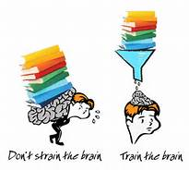
How Do We Learn
Association
Examples??
Idea first formalized by Aristotle 2000 years ago!
Habituation
Tolerance; decrease in response after continued presentation of a stimulus
Observation
Learning from others’ experiences and animals
Particularly true for complex animals
Learning allows animals to predict the future

Slide 5
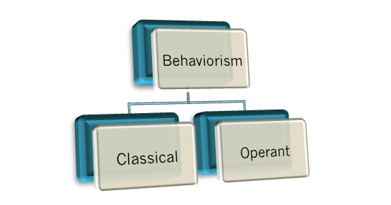
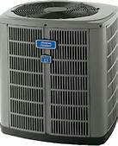
Conditioning
Conditioning=the process of learning an association
Types of condition
Operant- associate response and consequence→repeat acts followed by good results
Examples??
Classical- associate two stimuli→anticipate an event
Examples??
Can we utilize both types of conditioning at once?
!

Slide 6
Classical Conditioning

Slide 7
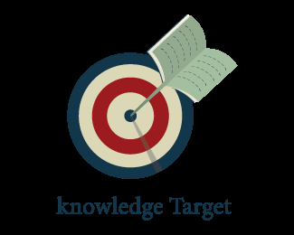
Learning Target
I can explain an example of classical conditioning using the terms unconditioned stimulus, conditioned stimulus, unconditioned response, and conditioned response.

Slide 8
Stimuli and Responses
Unconditioned Response
Unlearned, natural reaction to a stimulus
Ex. Salivating when food is in mouth
Unconditioned Stimulus
Stimulus that naturally produces a response
Ex. Food
Conditioned Response
Learned response to a previously neutral stimulus
Ex. Salivating when hearing a bell
Conditioned Stimulus
A stimulus that previously did not produce a response, but now does!
Ex. Bell
http://www.youtube.com/watch?feature=player_embedded&v=Eo7jcI8fAuI

Slide 9
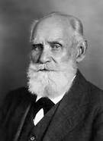
Ivan Pavlov
20th century Russian psychologist
Foundation for behaviorism
Disliked the “mentalistic” studies
e.g. consciousness, introspection
Focused on observable behavior
Basic laws of learning are universal among animals

Slide 10
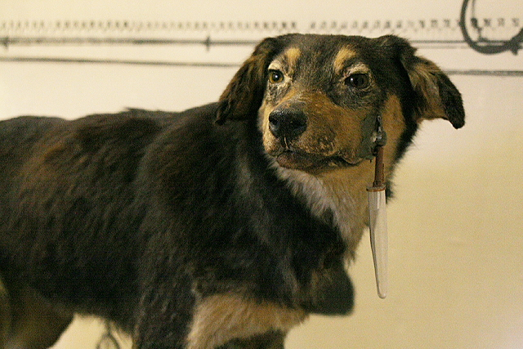
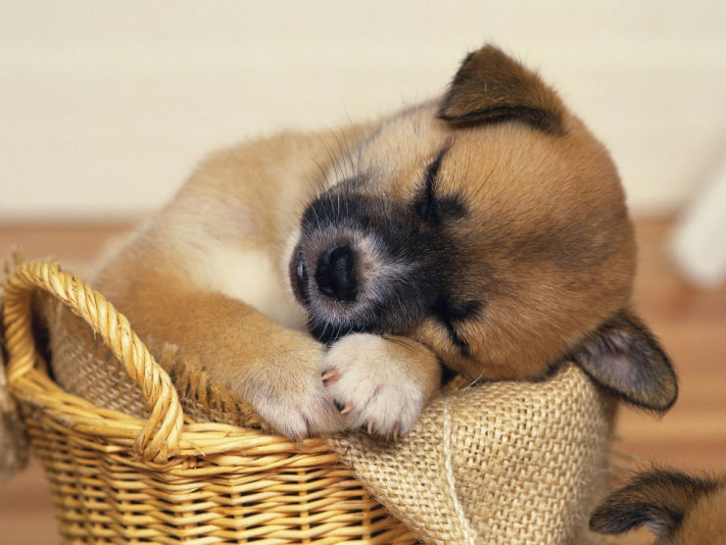
Pavlov’s Dogs: Foundation
Dog+Food in mouth=Saliva!
….
Dog+Sight of food=Saliva
…
HMMMMMM

Slide 11
Pavlov’s Dogs: The Experiment
http://www.youtube.com/watch?feature=player_embedded&v=FMJJpbRx_O8
Set Up
Small room
Harness
Saliva diverted to a measuring instrument
Provided food through a bowl/meat powder
Hypothesis: If a neutral stimulus is paired with food, then would the dog associate the stimulus with food and would he salivate to the neutral stimulus in anticipation of the food?
Moments before placing food in the dogs mouth, Pavlov sounded a bell.
Soon dog salivated at the sound of the bell

Slide 12
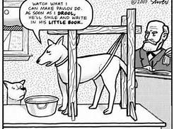

Slide 13
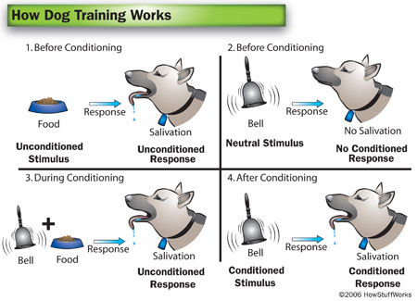
Pavlov’s Dogs: Results

Slide 14
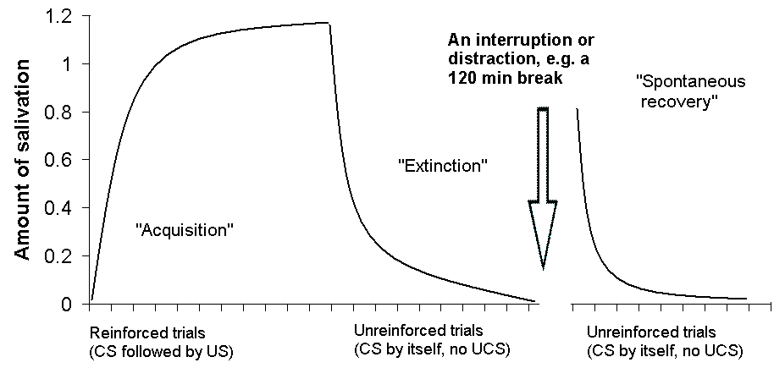
Conditioning Processes
Acquisition
Extinction
Spontaneous Recovery
Generalization
Discrimination

Slide 15
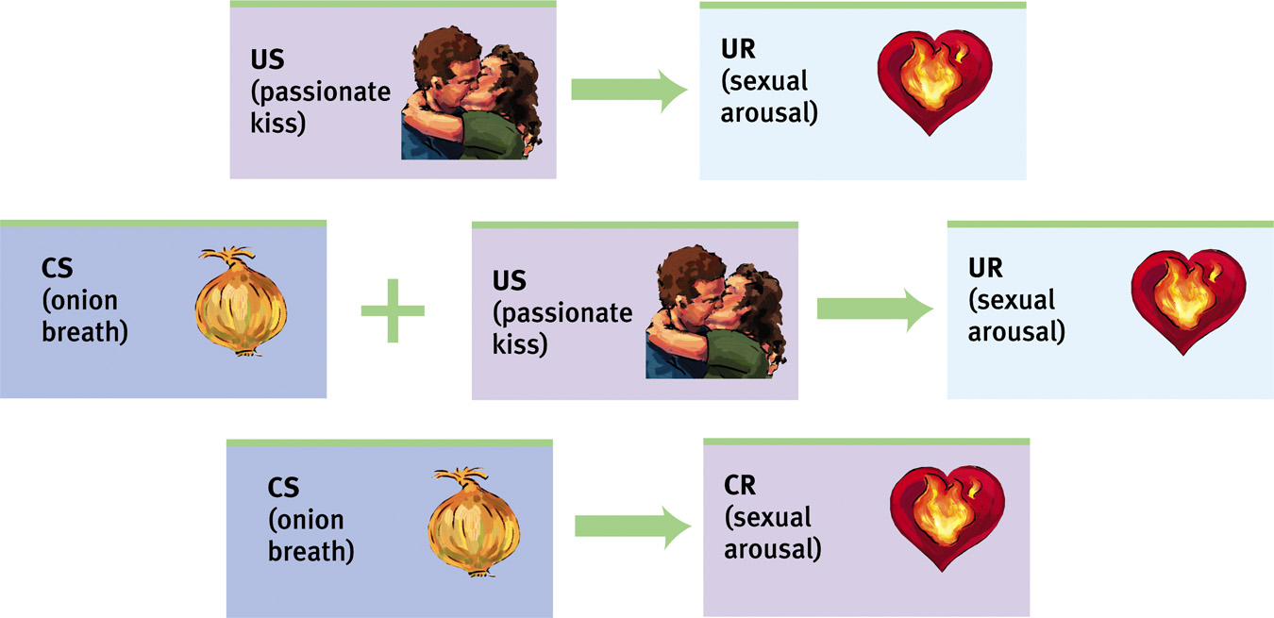
Acquisition
Acquisition=initial learning of the stimulus-response relationship
Timing between US and CS
Half a second=optimal time to develop an association
Order
Most of the time US must follow CS

Slide 16
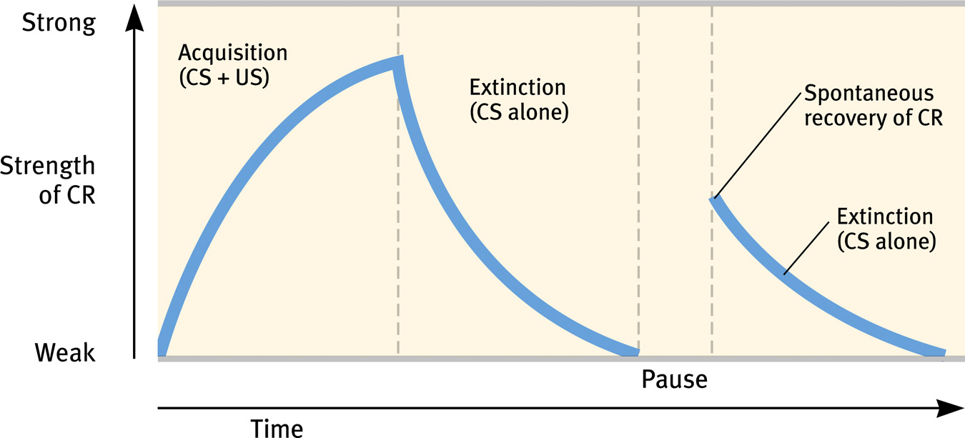
Extinction and Spontaneous Recovery
Extinction=The decrease in response when the CS stops signaling the US
Follow extinction with a pause….
And CR resumes
CR is weaker in recovery

Slide 17
Generalization
Generalization=tendency to respond to a similar CS
Ex:
Dogs: a similar sounding bell
Abused children: Image of angry faces produce stronger and more lasting brain activity
That which is naturally disgusting or appealing, cause us to like or dislike
Fudge shaped like poo=disgusting
Baby-faced adults=sweet, innocent, and cute

Slide 18
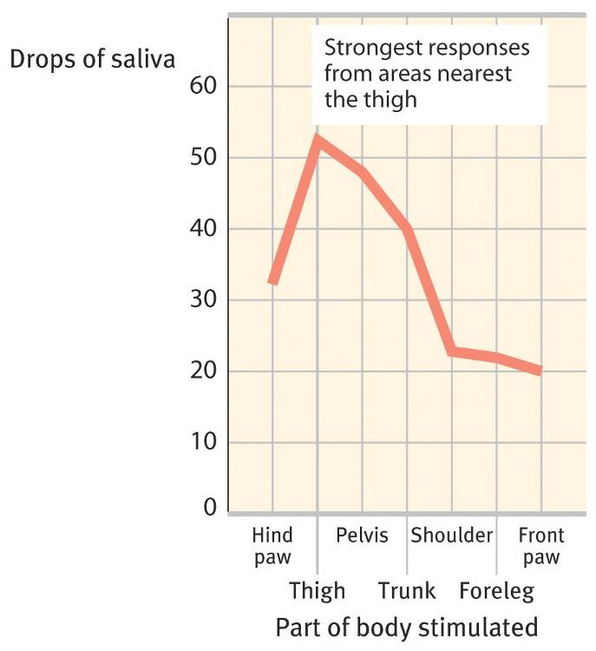
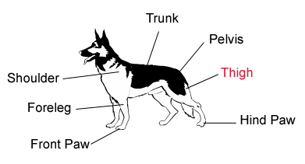

Slide 19
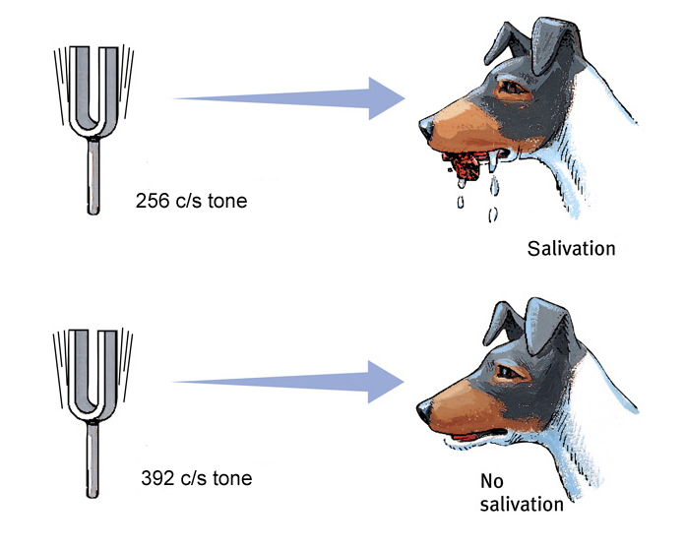
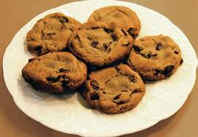
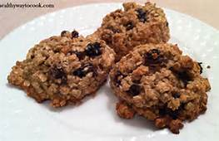
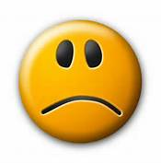
Discrimination
Discrimination=Ability to tell the difference between CS and other stimuli
Ex. Pit Bull v Golden Retriever

Slide 20
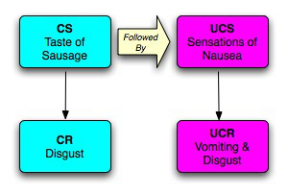

Slide 21
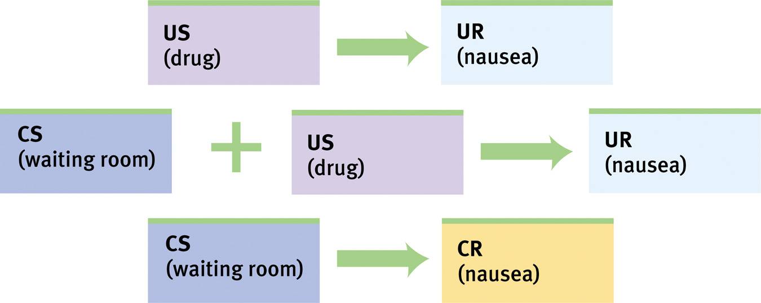

Slide 22
Pavlov’s Legacy
All organisms tested can be classically conditioned!
Objective empiricism
Isolate the building blocks of complex behaviors
Study with objective laboratory procedures
Applications
Addiction triggers
Habit breaking (e.g. alcoholism)
Immune system development

Slide 23
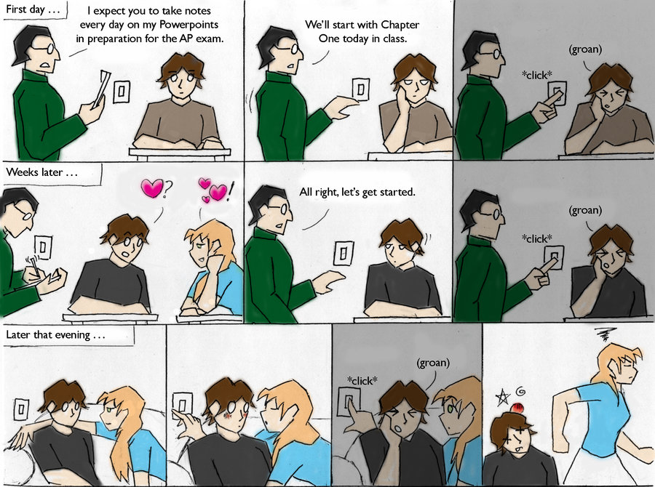

Slide 24
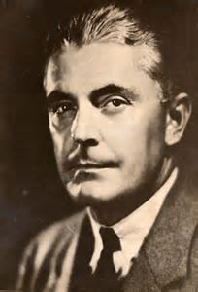
Little Albert
Psychologists: Watson and Rayner
Subject: Albert, 11th month old infant
US: Loud Noise/UR: Crying
CS: White Rat/CR: Crying
Generalization: crying/fear at many animals, even a sealskin coat!
Discrimination: no fear from toys
How could learning affect our own behavior? Is our behavior just a series of classically conditioned responses?
Watson became a famous marketing expert—even established the American “coffee break” to sell Maxwell House
http://www.youtube.com/watch?feature=player_embedded&v=HZPXVb0W3Hc

Slide 25
Operant Conditioning

Slide 26
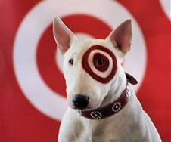
Learning Targets
I can explain the differences between classical and operant conditioning.

Slide 27
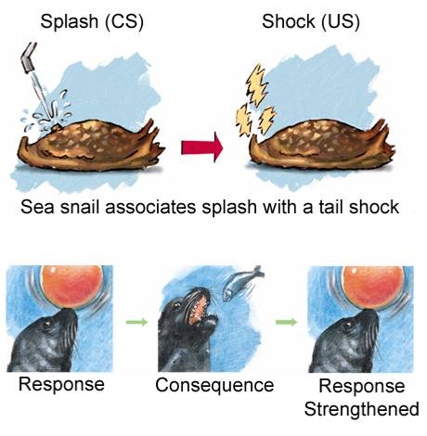
Basic Principles
Allows organisms to associate their own actions with consequences
Behaviors followed by reinforcers increase
Behaviors followed by punishers decrease.
Relies on operant behavior ( aka behavior operates to produce consequence)
Classical conditioning relies on respondent behavior
In operant conditioning the organism has control

Slide 28
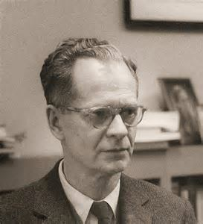
B.F. Skinner (1904-1990)
Modern behaviorists most influential (and controversial) figure
Based his work on the law of effect
Law of Effect=Rewarded behavior is likely to recur
Developed (and heavily utilized) an operant chamber, aka Skinner box
Bar/key to release reward of food or water
Device that records response
Results revealed conditions for efficient and lasting learning

Slide 29
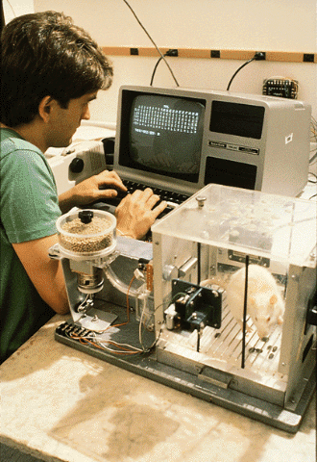

Slide 30
Shaping Behavior
Shaping=procedure which uses reinforcers to guide actions into a desirable behavior
Builds on existing behaviors
Regular intervals of increasing expectations
Reward behavior that is closer and closer to the ideal

Slide 31
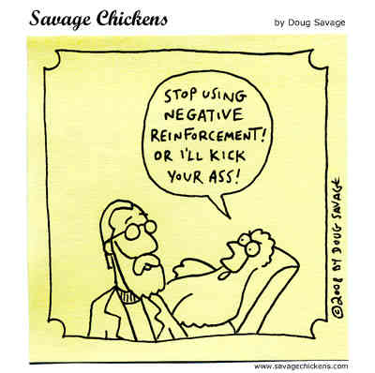
Types of Reinforcers
Reinforcers: any event that strengthens or increases the frequency of the response
Positive Reinforcers: Adding something good e.g. food when hungry
Negative Reinforcers: Removing something bad e.g. snooze button when alarm goes off
Note: Negative reinforcers are not punishments!
How does this relate to drug addictions?

Slide 32
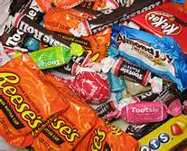
Other Reinforcers
Primary Reinforcers: responses that are innately satisfying
Conditioned Reinforcers: responses that are learned, satisfying by association
Immediate Reinforcers v. Delayed Reinforcers
Immediate reinforcers are often stronger
Choosing delayed reinforcers is a sign of maturity
Examples?

Slide 33
Learning Target
I can describe the pros and cons of the four different reinforcement schedules.

Slide 34
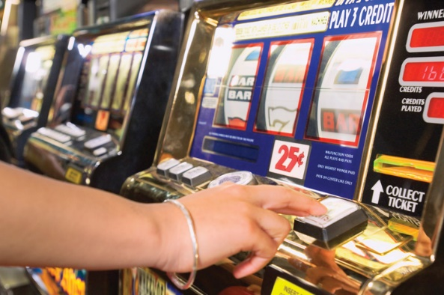
Reinforcement Schedule
Continuous Reinforcement: Every desirable response is followed by reinforcement
Rapid learning
Rapid extinction
Partial/intermittent reinforcement: Sometimes response is reinforced
Far more realistic
Initial learning is slower
Greater permanence—resistant to extinction
What is the best way to learn: continuous or partial?
Examples?

Slide 35
Types of Schedules
Fixed Ratio: Reinforced after a set number of correct responses
High rate of responses
Variable Ratio: Reinforced after a variable number of correct responses
High rate of responses
High consistency of responses
Ex. Slot machines
Fixed Interval: Reinforced after a set amount of time has passed
Rate of responses corresponds with time of reward
Ex: mail
Variable Interval: Reinforced after a variable amount of time has passed
Slow and steady and steady rate of response
Ex: email or Facebook notifications

Slide 36
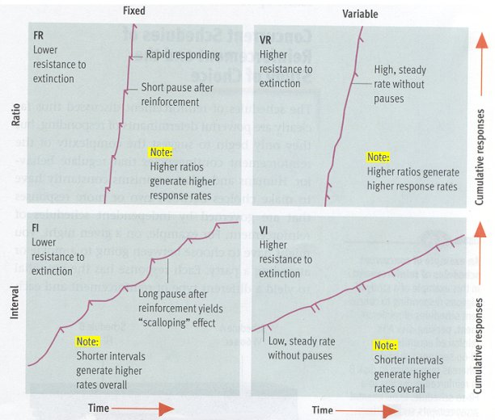

Slide 37
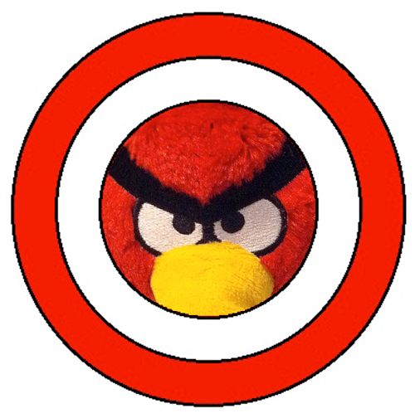
Learning Target
I can argue for and against punishment as a teaching tool.

Slide 38
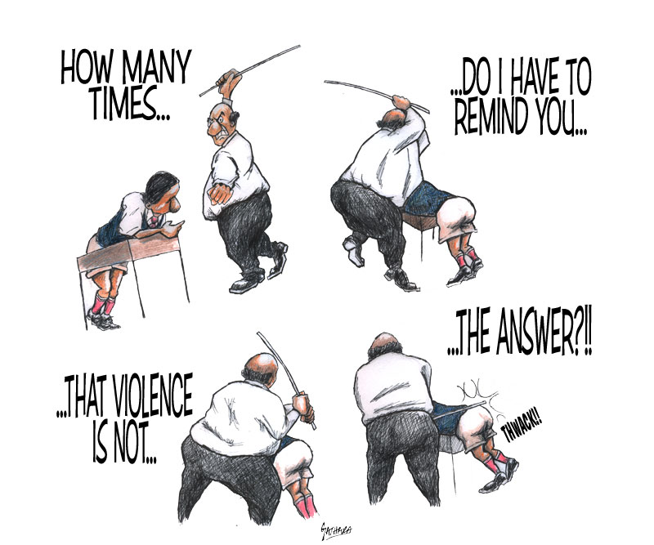
Punishment
Reinforcers increase behavior, punishment decreases behavior
Physical punishment→aggressive/antisocial behavior
Chicken and egg phenomenon
Punishment provides no guidance towards desired behavior
Punishment teaches how to avoid the undesirable consequence
What combination of punishment and reinforcement is most effective?

Slide 39
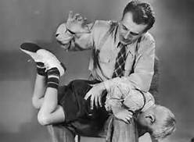
Spanking
Used in combination with authoritative parenting
Punished behavior is suppressed—it will reappear when safe from punishment (discrimination!)
Shows aggression is a way to handle problems
Fear associated with punishment and the punisher ( example of __________ conditioning)
Correlated with helplessness and depression

Slide 40
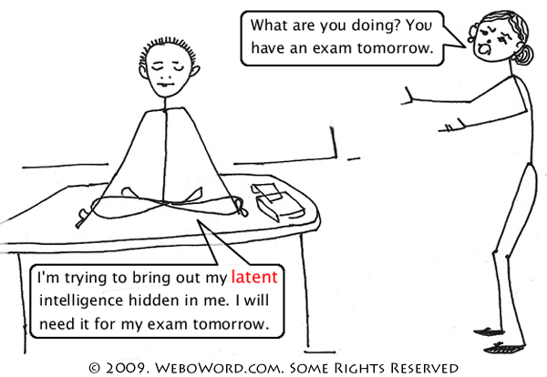
Role of Cognition in Operant Conditioning
Latent Learning: learning that becomes apparent only when there is reward for demonstrating
We “learn” without reinforcement
Learning as something different from conditioning
Ex. Rats in a maze

Slide 41
Learning Target
I can describe how motivation affects conditioning.

Slide 42
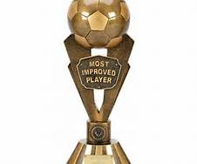
Motivation
Intrinsic Motivation: desire to perform for its own sake—enjoyment, interest, self expression, challenge
More effective—behavior is more lasting and more frequent!
Extrinsic Motivation: desire to perform for external rewards or to avoid punishment
Less effective
Best approach uses internal motivation and then external rewards to reinforce a job well done
Reward to boost natural feeling of success increases enjoyment
Rewards can improve creativity and performance

Slide 43
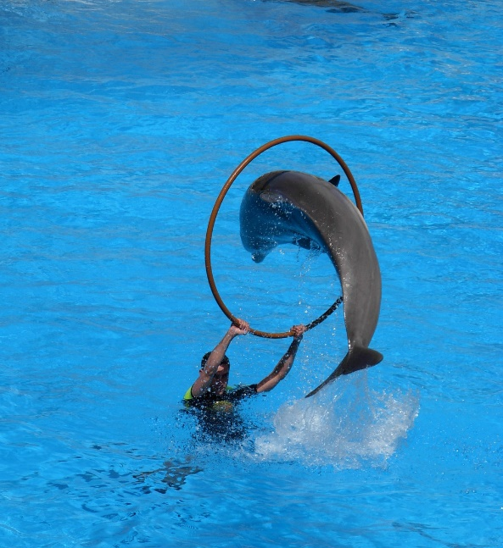
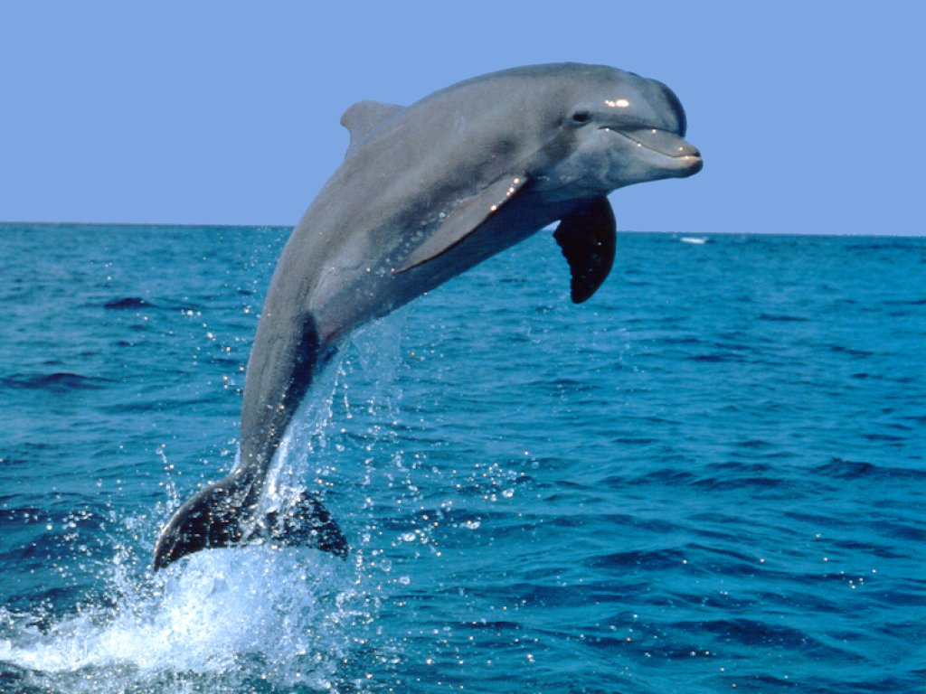
Biological Predispositions
We learn associations that correlate naturally
Food is a good reward for hamster digging, but not face washing
Digging naturally leads to food
Instinctive drift describes the animals tendency to revert to natural behavior

Slide 44
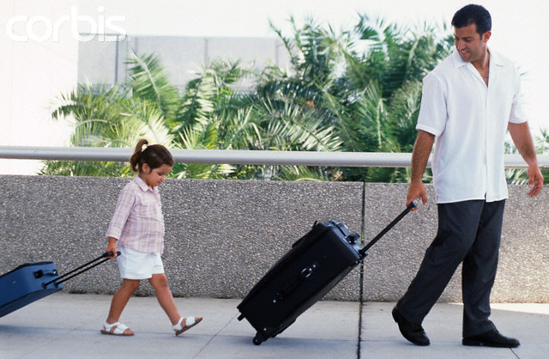
Learning by Observation

Slide 45
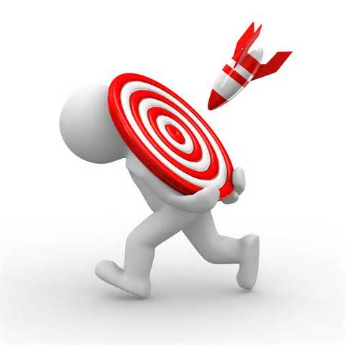
Learning Target
I can explain how social learning shapes the argument for and against violent media.

Slide 46
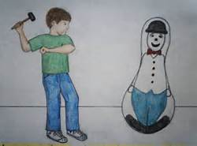
Albert Bandura: Social Learning Theory
http://www.youtube.com/watch?feature=player_embedded&v=NjTxQy_U3ac
Results
More likely to imitate behaviors of those we perceive as similar to ourselves
More likely to imitate behaviors that have positive consequences or at least no negative consequences
Contemporary Examples?
Prosocial Learning: learning from good examples
The earlier the better!

Slide 47
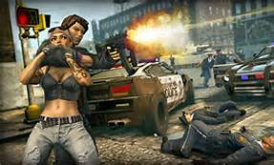
Television…video games?
66.67% of US homes have three+ TVs
Most characters are young, single, and non-Hispanic
Many shows are violent-crime heavy
~ Child sees 8000 TV murders and 100,000 other acts of violence before finishing elementary school (not including cable or movies)
Results
More time elementary students engage with violent media, more often they get into fights
More at risk for aggression and crime as teens and adults
Homicide rates correlate with spread of TV media
Role of desensitization

