Slide 1
Kony 2012
An Evaluation

Slide 2
Do Now
Consider your reactions to the Kony 2012 movie, choose a position based on the options below
YES! Sign me up, I am ready to make a change!
I’ll share it, but I’m not sure I am actually going to become involved.
I’m interested, but I don’t have enough information to support or refute this cause.
Nice video, but I am going to pass, leave me out of it.

Slide 3
Learning Targets
Describe the conflict surrounding the LRA.
Evaluate the effectiveness and accuracy of the Kony 2012 video.
Evaluate the role of social media in African conflicts.

Slide 4
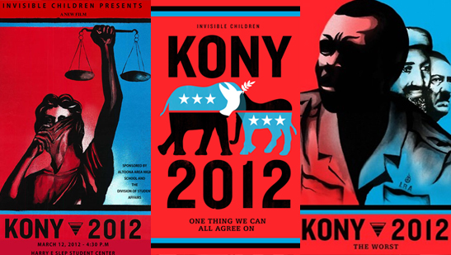
What is the purpose of Kony 2012?

Slide 5
Plan of Action
Today: jigsaw to analyze and evaluate different parts of Kony 2012
Monday (woohoo!): shuffle groups and create a poster that illustrates the accuracies and effectiveness of Kony 2012 and its shortcomings

Slide 6
Exit Ticket-Answer the question below
Is Kony 2012:
Accurate in illustrating the LRA conflict? Give three reasons why or why not.
Effective at achieving its purpose? Give three reasons why or why not.

