Slide 1
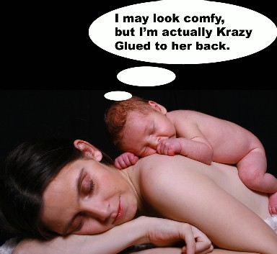
Attachment Theory
Childhood and Beyond

Slide 2
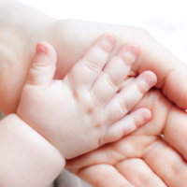
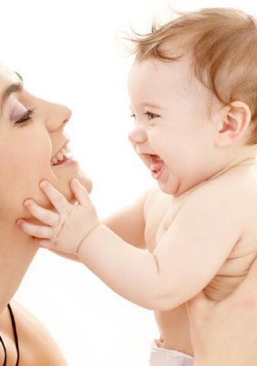
Attachment in Childhood
Questions to consider
What is attachment?
Who do children attach to?
Why do children attach to certain individuals?
How do we measure attachment in children?
What are the effects of attachment?

Slide 3
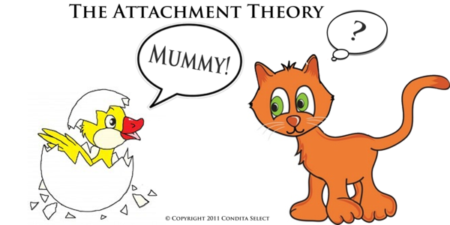
Attachment
Attachment: The emotional tie with another person
Seeking closeness regularly
Distress upon separation
Who do children become attached to?
Caregiver→parent

Slide 4
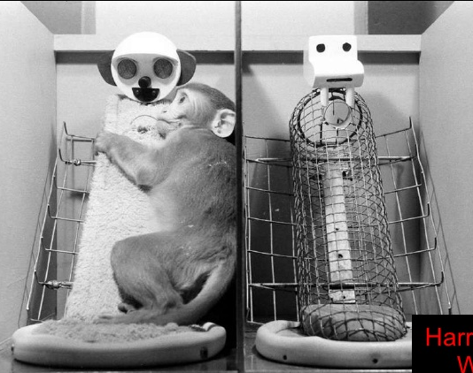
Elements of Attachment
Body Contact
Nourishment or comfort?
Harry Haslow: tests the concept on baby monkeys. Baby
monkey preferred the cuddly “mom” not the food providing mom.
Familiarity
Familiarity→contentment
Humans do not imprint during a critical period
Imprint: Process when animals form strong attachments during a critical period soon after birth
Critical Period: The optimal time for specific developments based on heightened sensitivity to outside stimuli/environmental affects. Usually follows shortly after birth
Responsiveness
Parent acknowledgement of child followed by appropriate response.
Responsiveness is a key predictor of secure or insecure attachment
http://www.youtube.com/watch?feature=player_embedded&v=ST0pUHcVjzI

Slide 5
Parenting Styles
Authoritarian: http://www.youtube.com/watch?feature=player_embedded&v=Zh1zIx-qidE
Warmth: Low
Communication: Parent→Child
Maturity: High expectations of child
Discipline: Strict and often physical
Permissive: http://www.youtube.com/watch?feature=player_embedded&v=K-3GfzozLL8
Warmth: High
Communication: Child→Parent
Maturity: Low expectations of child
Discipline: Lax
Authoritative→children with self-confidence, self-esteem, and self-reliance through allowing children to develop a sense of control
Warmth: High
Communication: Parent→Child and Child→Parent
Maturity: Moderate expectations of child
Discipline: Moderate, marked by clear rules with enforcement and explanation

Slide 6
Authoritarian
Authoritative
Neglectful
Permissive
Withdrawn
Apathetic
Shy Girls and Hostile Boys
Unmotivated
Incompetent
Unmotivated
Self-effacing
Indifferent
Destructive
Detached
Socially Incompetent
Self Assertive
Independent
Friendly
Cooperative
Motivated
Competent
Impulsive
Dependent
Undisciplined
Immature—risk taker
Manipulative
Socially Competent
Self-Centered
High Demands
Low Responsiveness
High Responsiveness
Low Demands

Slide 7
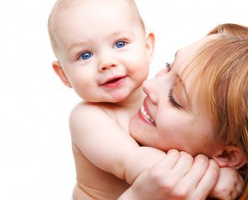
Effects of Attachment
Secure Attachment
Leads to social competence: confidence, outgoing, persistent in solving challenging tasks
Identity Development
Insecure Attachment
Withdrawn and frightened
Clingy
Adoption
Neglected children adopted into healthy environments between 6-16 months show no negative effects of neglect

Slide 8
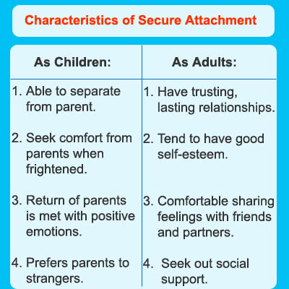

Slide 9
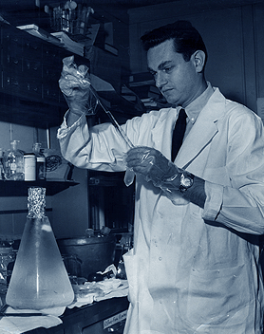
How do we measure attachment in children?
With your neighbor, design an experiment, which uses the scientific method to measure attachment of children.
Don’t forget to:
Be SPECIFIC!
Be ethical
Use a random sample
Form a hypothesis
Define your variables
http://www.youtube.com/watch?v=s608077NtNI

Slide 10
Parenting 101
You and your group are assigned to develop a “Good Parenting PSA”
Write the script for how you would preform your PSA
Hint: modeling (or at least describing) the four types of parenting and their effects will be useful
Hint: expert testimony is always very convincing
Be prepared to act out your PSA

