Slide 1
The Arab Empire
Period Two

Slide 2
Timeline
Arab Empire

Slide 3
Brief Timeline of the Arab Empire
634- The Arabs surge North into Syrian desert
637- Defeat Persian army at Kadisiya, brings end to Sassanian dynasty
638- Capture Jerusalem, Palestine and Syria under Muslim control
642- Capture of Alexandria completes the Muslim conquest of Egypt
691- Dome of the rock is completed as a Muslim shrine on the temple of mount Jerusalem
711- Aras cross from North Africa into Spain and drive Visigoths from Toledo
732- Advance to France, however they were defeated
751- Battle at Talas river between Chinese and Arabs. Arabs are victorious
756- Abd-ar-Rahman, escaping from massacre of his family in Syria, establishes a new Umayyed Dynasty
762- the Abbasid Caliph create Baghdad as new capital city on the Tigris
1916- Sharif Hussein, the emir of Mecca proclaims himself the leader of the Muslim world, thus launching an Arab revolt against the Ottoman Empire

Slide 4
Leaders and Politics
The Arab Empire

Slide 5
Arab Empire
Noteworthy leaders and political structure:
It was the Muslims of Arabia, settled people alike, whose invasion was in the 6th and 7th century. They found a enormous empire, which is stretched out from the Atlantic Ocean on the west, across North America and the Middle East, to central Asia on the east. The Arabian people became the rulers of several different people. Slowly but surely, a great Arab civilization was built. Some of Arab cultural leaders weren’t all Arab, some were not even Muslims. Some of the leaders were Christians and Jews. The civilization reflected the Arab values, tastes and traditions. Education developed quickly in the Islamic Lands. Literature, philosophy, medicine, mathematics and science were developed by the Arabian people. Arabic became the head spoken language.
The politics of Saudi Arabia takes places in the situation of a complete monarchy founded upon the texts of Islam. The king of Saudi Arabia is both head state and the head of the government.

Slide 6
Territories
Arab Empire

Slide 7
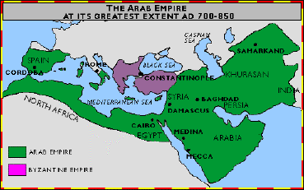
Arab Empire: Territories
http://www.westmifflinmoritz.com/Mesopotamia_Folder/Islamic%20Empire.htm

Slide 8
Empire Beginnings and Ends
Arab Empire

Slide 9
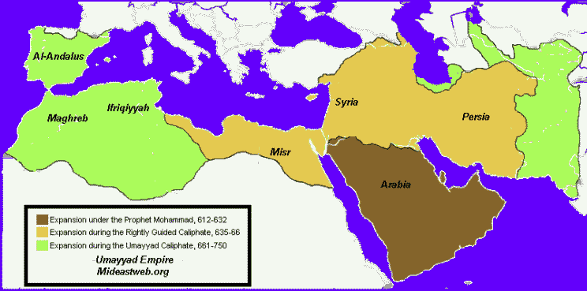
Empire beginning and ending

Slide 10
The Arab conquest of the ancient world in the 7th and 8th centuries saw them launched as an imperial system with rapidity unmatched in history. In a matter of a century they held sway from the border of France to Central Asia, Spain, North Africa, The Byzantine territory and the Persian Empire.
During the Abbasid dynasty of 750, convert Muslims and client peoples moved from the fringes of the new society to the centre bringing with them their heritage, culture and civilisation. In this way outstanding achievement of Muslim culture appeared. Arab literature reached its peak; the great code of Canon Law was formulated; philosophy, science and medicine were given new dimension and content. Muslim civilisation – rich, sophisticated, varied symbolised societies of the Islamic world and took its place among the great cultural achievements of human history. Arab conquest brought with it constructive forces that set the stage for a civilisation to emerge (unlike other Mongol conquest which left ruins and destruction).

Slide 11
In 969 the Fatimids of Tunisia, claiming descent through the Prophet's daughter, conquered Egypt and refused to recognize the authority of the Caliph in Baghdad.This caused the breakup of the Arab Empire.
When Muhammad, the Prophet of Islam, died in 632 the new religion had already gathered a number of impressive victories on the battlefield. The armies of Islam quickly and easily conquered the Arabian peninsula before moving on to take the homelands of their various neighbours. Marching out of Arabia in 639 they entered non-Arab Egypt; 43 years later they reached the shores of the Atlantic; and in 711 they invaded Spain. In just 70 years they had subdued the whole of North Africa, instituting a new order. This conquest, from the Nile to the Atlantic, was more complete than anything achieved by previous invaders and the changes it wrought proved permanent.

