Slide 1
Algeria
Period 2
Kaitlyn J.
Grace M.
Jasmine S.
Mac B.

Slide 2
Learning Targets
I will be able to find Algeria on a map
I will be able to know the political structure of Algeria
I will know conflicts going on in Algeria
I will know the UN involvement
Lastly, I will know the Current Status of Algeria

Slide 3
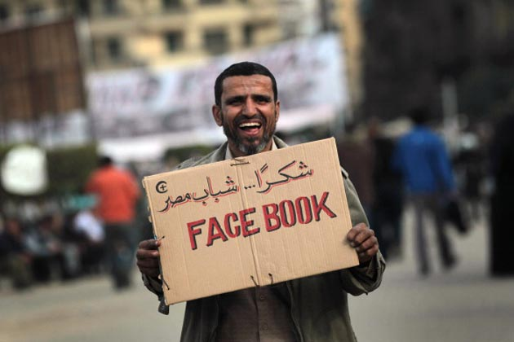
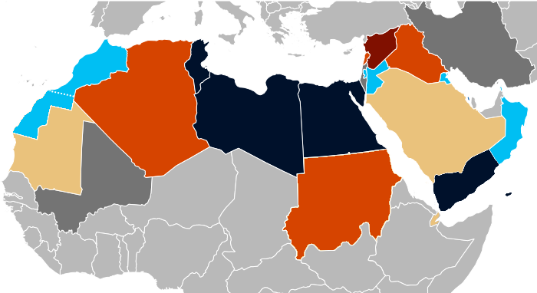
Arab Spring
December 18, 2010
“A vigorous and healthy new version of civil society”(Bostonglobe.com)
Shia and Sunni
Social Networking
Egyptian Social Democratic Party (page)
Want more info? Go to
bostonglobe.com
Notes:
Jan 7 2011- throwing stones
Jan 13- man burned himself
Feb 12- police beat back 2000
March-15 oil revenue to boost pay
Aug 29- dictators wife + 3 children
Sep 25- 8 killed in attack

Slide 4
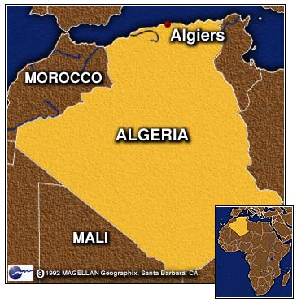
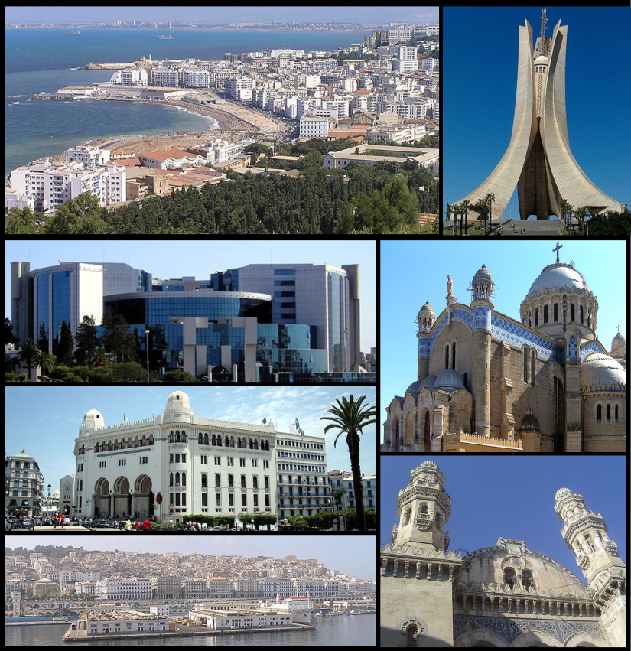
Geography
Capital
Algiers
2nd Largest
10th Largest
Saharan Region
85%
infoplease.com
Notes:
Four times the size of Texas. Sahara desert is 85 % of country tenth largest in the world

Slide 5
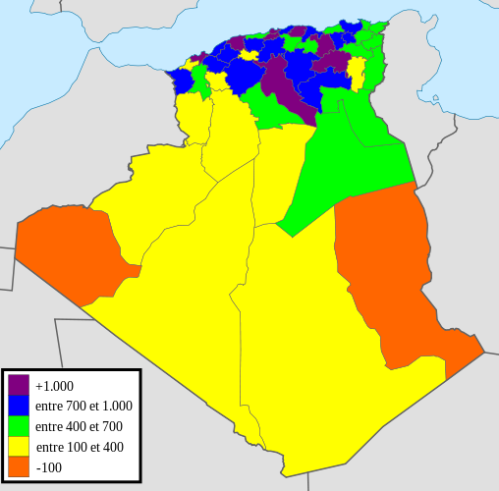
Population
Political Structure
Presidential Republic
38.48 Million
Islam
Sunni
Freedom of Religion
Official Language
Arab
wikipedia.org
Notes:
In 1960 the population was only 11.28 million

Slide 6
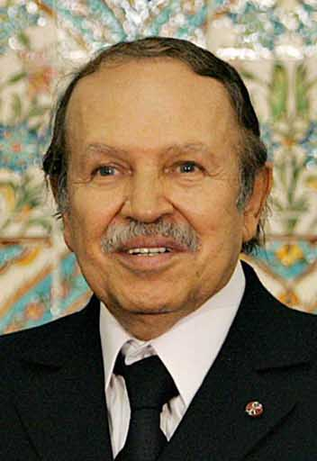
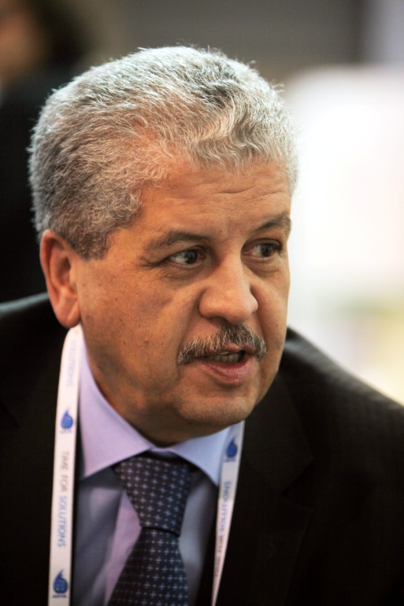
Political Structure
President
Abdelaziz Bouteflika
“Authoritarian”(nationalinterest.com)
Health Problems
Prime Minister
Abdelmalek Sellal
Government
Egypt Structure
Nationalinterest.org
Notes:
The structure is a lot like Egypt’s right now. But pres says his is better. (Learns from Egypt's mistakes)
He had a stroke and will not be able to run for president next term. President is Sunni.
Prime minister in charge of government

Slide 7
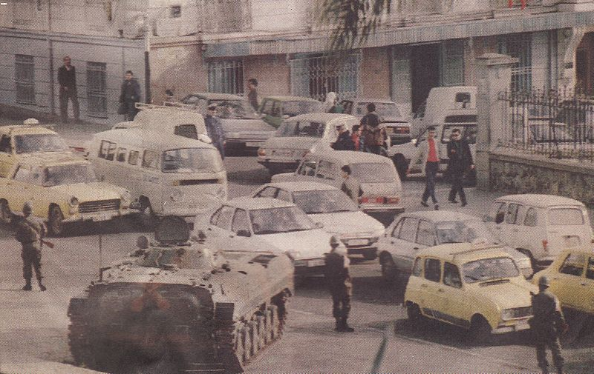
Conflict Beginnings
War
“Future oil and gas supplies for Europe could be at stake” (highbeam.com)
French
1830
1962
1950s- Present Time
highbeam.com
historytoday.com
Notes:
1830- French conquest for Algeria began
1962- French took Algeria

Slide 8
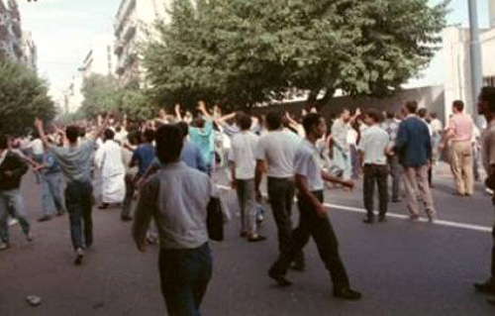
Conflict Development
70% under 30 years old
Northern Africa
22% unemployment
afrik-news.com

Slide 9
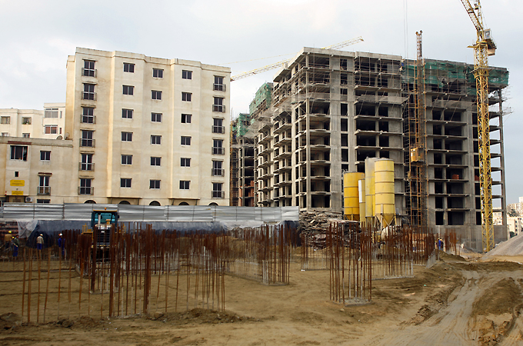
Similar Riots/ Protests
53 injured
29 arrested
Housing
Inadequate
“Tunisian frustration”
Jobless Youths
New programs
zawya.com

Slide 10
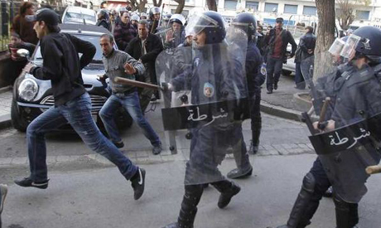
Low Income
Police
40,000
March to Birkhadem
Heat
48 kilometers (30 miles)

Slide 11
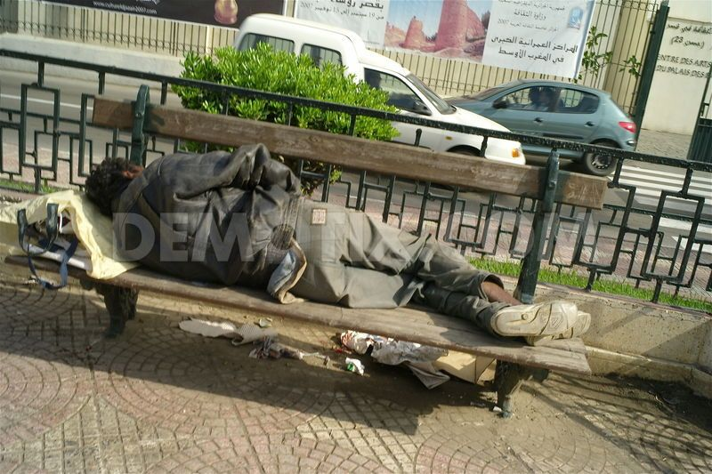
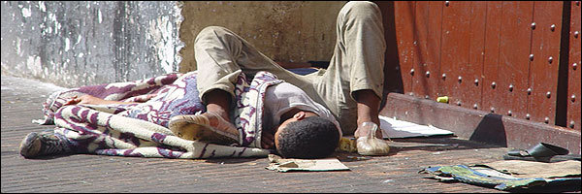
Homelessness
Authorities
Photographs
Rate
Annual growth 3%
Born homeless

Slide 12
Limitation: Human Rights
Restrictions:
Assembly and Association
“Change the Government Peacefully”
Prison Conditions
Prisoner Abuse
No Government Transparency
Many more. . . Visit this site
state.gov

Slide 13
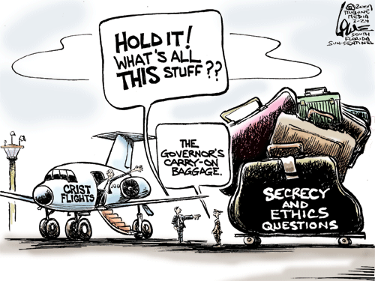
Corruption
Transparency Governmental access
92nd out of 180
Increasing
East-West Highway Project
Delays
Waste
11 Billion Dollars

Slide 14
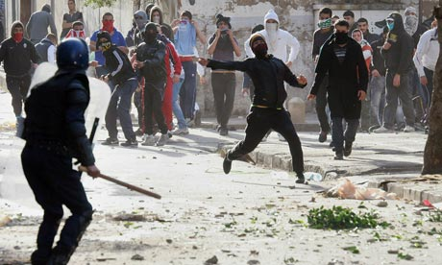
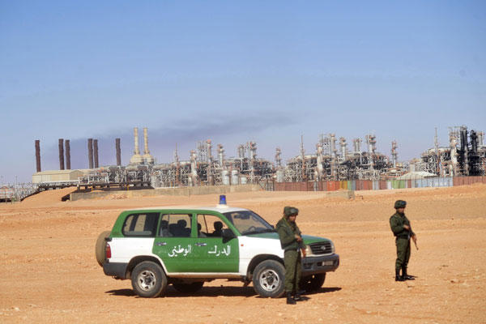
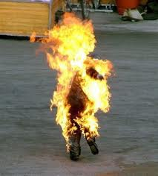
Timeline
January 7, 2011
January 13, 2011
February 12, 2011
March 15, 2011

Slide 15
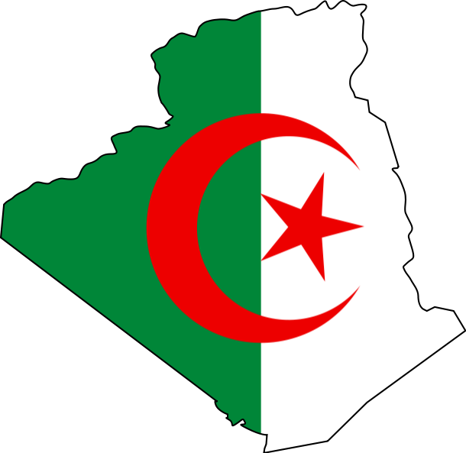
Political Structure (Continued)
Legislative Power
2 chambers
People’s National Assembly
Council of the Nation
Women’s movement
Post war
International Women’s day- supported
Education
Limits
Employment
Political Power
Autonomy
Though Content
Notes:
Pretty much said go home and make sandwiches your done

Slide 16
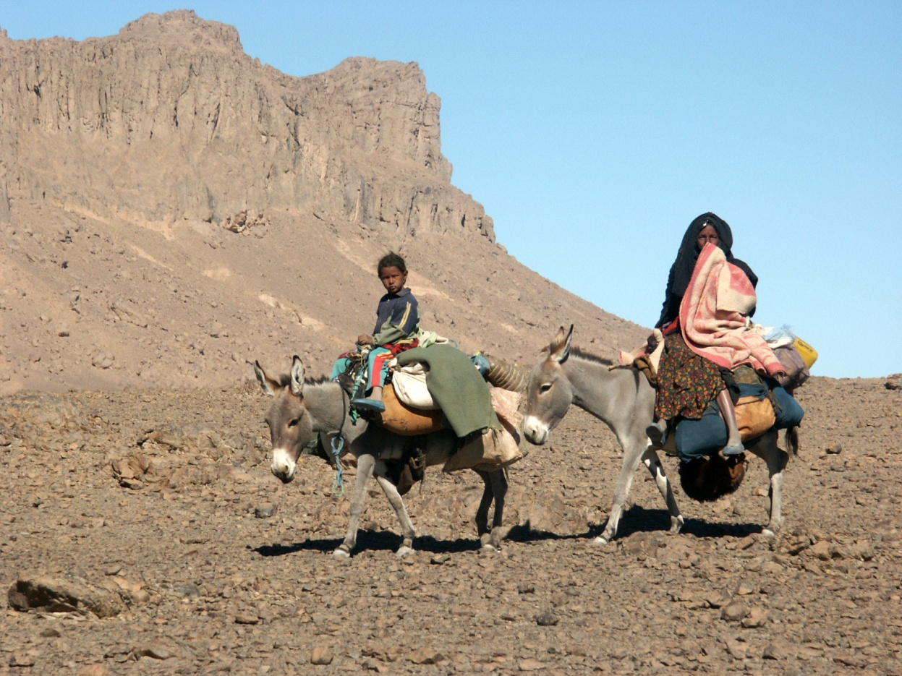
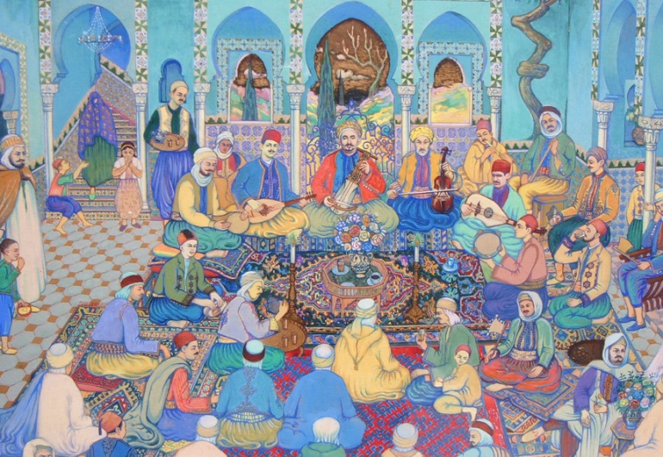
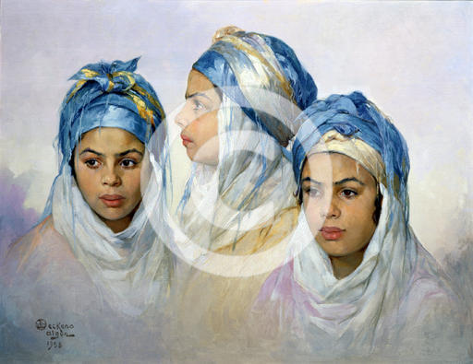
Social Changes
War of Independence
1962
8 years of war
Complex
Guerrilla Warfare
Terrorism
New Identities
Roles
Abilities
Women
New Leaders
Personality vs Position

Slide 17
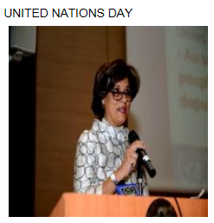
United Nations involvement:
Algeria is viewed positively by the United Nations
Reliable Partner
International Law
Global Issues
UNDP (United Nations Global Development Network):
Human Development
Governance
Environmental Protection
United Nations involvement = minimal

Slide 18
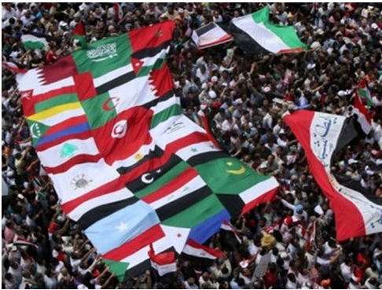
Current Status:
Demonstrations of Arab Spring = not a problem in Algeria
Algeria relatively calm country regarding uprisings
More prosperity and free speech compared to other Arab countries
Less potential for civil revolt

Slide 19
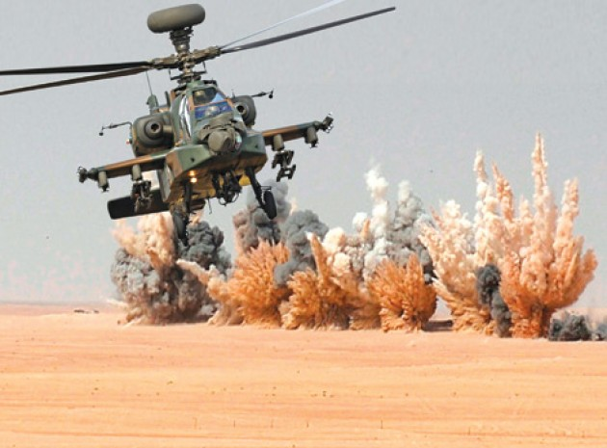
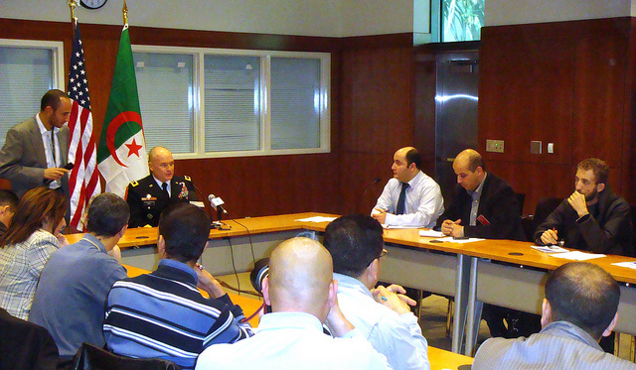
Current Status continued:
Possible regional power:
Well equipped military (largest defense budget in Africa)
Counter terrorism expertise
Large energy reserves
Stable country
Growing economy
Good trade partner (United States and England)

Slide 20
Citations- Primary
"Algeria, UN Reliable Partner, Says Ana Cristina Costa Amaral - APS : Algérie Presse Service." Algeria, UN Reliable Partner, Says Ana Cristina Costa Amaral - APS : Algérie Presse Service. Algeria Press Service, 29 Oct. 2013. Web. 03 Nov. 2013. <http://www.aps.dz/Algeria-UN-reliable-partner-says.html>.
"Bouteflika's Speech to the Nation." BBC News. BBC, 27 Apr. 1999. Web. 04 Nov. 2013. <http://news.bbc.co.uk/2/hi/world/monitoring/330016.stm>.
"Dialogue among Civilizations: Address by Abdelaziz Bouteflika (Algeria)." Dialogue among Civilizations: Address by Abdelaziz Bouteflika (Algeria). N.p., n.d. Web. 04 Nov. 2013. <http://www.unesco.org/dialogue/en/bouteflika.htm>.

Slide 21
Citations- Secondary
Dehezon, Dustin. "Is Algeria the Odd One Out in the Arab Spring?" The North Africa Post RSS. N.p., 21 Aug. 2013. Web. 03 Nov. 2013. <http://northafricapost.com/4194-is-algeria-the-odd-one-out-in-the-arab-spring.html>.
Hussain, Ghaffar. "After the Arab Spring: Algeria's Standing in a New World." The Commentator. N.p., 25 Mar. 2013. Web. 04 Nov. 2013. <http://www.thecommentator.com/article/3030/after_the_arab_spring_algeria_s_standing_in_a_new_world>.
"Is Algeria Immune from the Arab Spring?" BBC News. BBC, 27 July 2011. Web. 30 Oct. 2013. <http://www.bbc.co.uk/news/world-africa-14167481>.

Slide 22
Citations- Secondary
Manfreda, Primoz. "Definition of the Arab Spring." About.com Middle East Issues. N.p., n.d. Web. 04 Nov. 2013. <http://middleeast.about.com/od/humanrightsdemocracy/a/Definition-Of-The-Arab-Spring.htm>.
"UNDP Algeria: Who We Are and What We Do?" United Nations Development Program. N.p., Sept. 2007. Web. 03 Nov. 2013. <http://www.dz.undp.org/anglais/index0.html>.

Slide 23
Citations- Primary
Cambanis, Thanassis. "Ideas." BostonGlobe.com. N.p., 27 Oct. 2013. Web. 06 Nov. 2013.
Nisman, Daniel. "A Last Stand for Algeria's President." The National Interest. N.p., 8 Oct. 2013. Web. 5 Nov. 2013.

Slide 24
Citations- Secondary
"Geography." Infoplease. Infoplease, n.d. Web. 06 Nov. 2013.
"Freedom of Religion in Algeria." Wikipedia. Wikimedia Foundation, 11 Feb. 2013. Web. 06 Nov. 2013.
Pierre, Andrew J. "Algeria's War on Itself." - Foreign Policy. N.p., 22 June 1995. Web. 06 Nov. 2013.
Evans, Martin. "French Resistance and the Algerian War." History Today. N.p., n.d. Web. 06 Nov. 2013.

Slide 25
Citations
http://www.afrik-news.com/article18940.html
http://www.zawya.com/story/The_irony_of_Spring-ZAWYA20120527051735/
http://www.aljazeera.com/news/africa/2010/12/2010123012345588575.html
http://english.ahram.org.eg/NewsContent/2/8/47283/World/Region/Algerian-police-auxiliaries-march-for-pay-rises.aspx
http://www.demotix.com/news/2024688/beggars-and-homeless-city-center-algiers#media-2024604
http://zawaya.magharebia.com/old_zawaya/en_GB/zawaya/opinion/126.html

Slide 26
Citations
http://www.state.gov/j/drl/rls/hrrpt/2010/nea/154458.htm
http://vivalalgerie.wordpress.com/2010/01/03/fighting-against-corruption-in-algeria/
http://en.wikipedia.org/wiki/Algeria_East%E2%80%93West_Highway
http://www.ask.com/web?q=what+are+some+issues+in+algeria&qsrc=0&o=102280&1=dir&adt=0
http://www.mongabay.com/history/algeria/algeria-the_revolution_and_social_change.html#OXFyt9Vc4beCumAd.99

